Slide 1
Above Ground Products
2013 Distributor Meeting

Slide 2

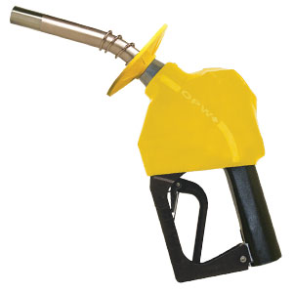
The New Look of OPW Premium Nozzles
Stainless Steel Spout Tip
Extends life of the spout by a factor of 4.
Improved B-Cap
Improved Shut off reliability.
Contoured Edges do not puncture the hand warmer.
Two Piece Hand Warmer
Customers prefer, cleaner appearance/feel.
Easier to replace the hand warmer. Do not have to cut the hand warmer or remove the hose.
Reinforced Latch Spring
Ensures the nozzle lever drops out of rack more consistently

Slide 3
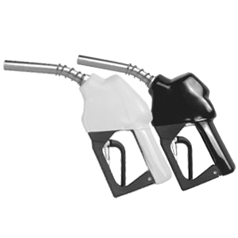
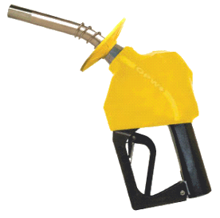
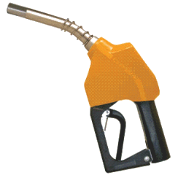
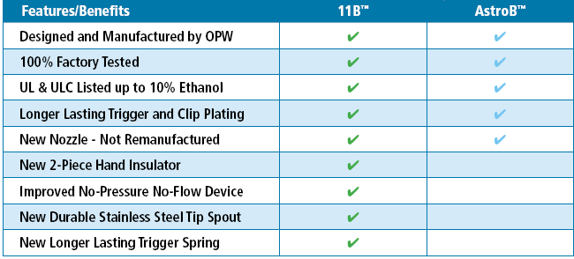
Conventional Nozzle Portfolio
Additional Features Available
P

Slide 4
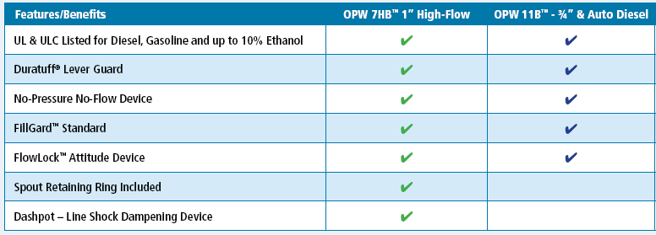
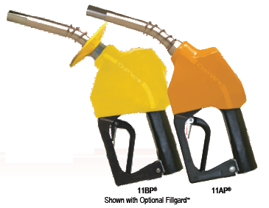
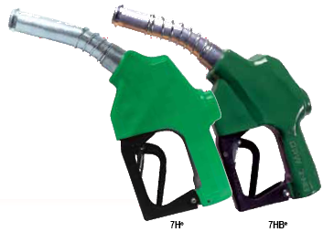
Diesel Automatic Shut-Off Nozzles
11AF nozzles are meant for Transfer Pump applications and non-Retail use. See OPW catalog for more details

Slide 5

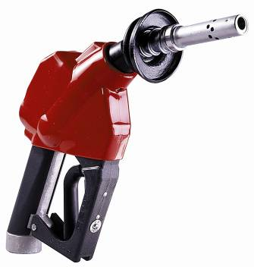
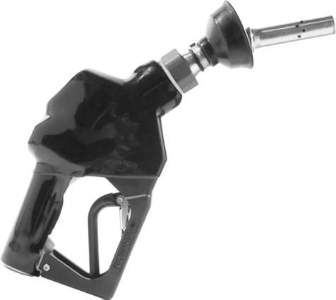
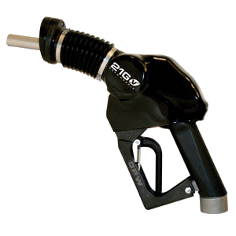
Changing to meet our customers needs!
Value .

Slide 6
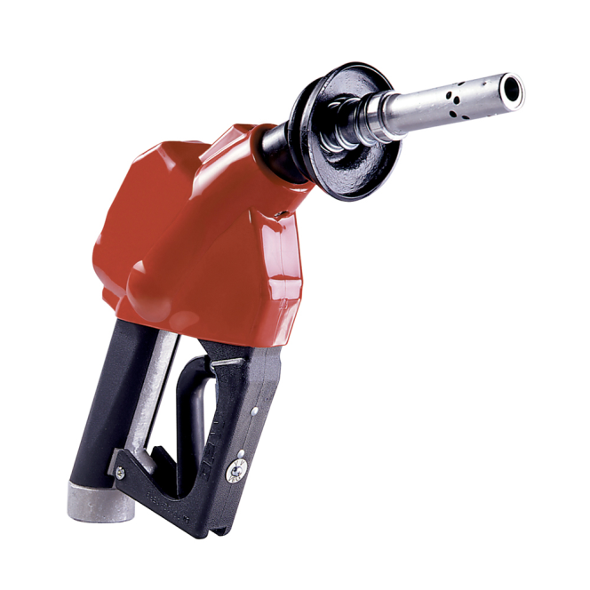
OPW ANNOUNCES ENHANCED PRODUCT WARRANTY ON
12VW SERIES VAPOR RECOVERY NOZZLES
Effective May 1, 2010 all new OPW 12VW
series vapor recovery nozzles beginning in
serial number 500000 and greater come
standard with a special 2Year Enhanced
Warranty*.
This special warranty offer is designed to
reinforce our commitment to quality and to
stand behind what we know is the best built vacuum assist nozzle in the business.
Two Piece Hand Warmer

Slide 7

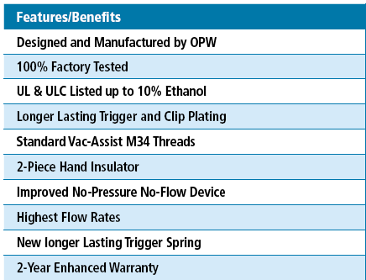
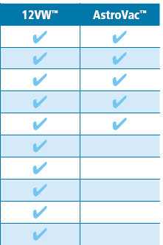
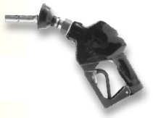
Vapor Recovery – Vacuum-Assist Nozzles

Slide 8

Logos and Nozzle Advertisement

Slide 9

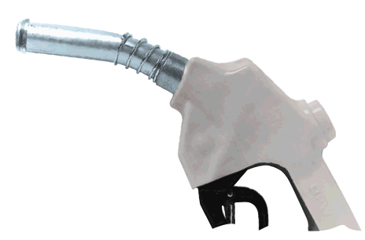

OPW XC – Extreme Cold Weather Nozzles
The world’s first automatic nozzle to function at -54ºC
Featured in:
By Convenience & Carwash Canada

Slide 10

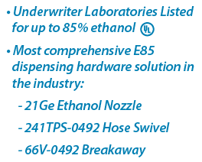
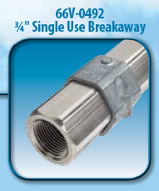
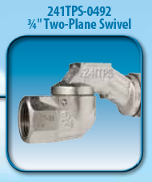
21Ge™ - E85 UL Listed Hanging Hardware
The world’s first UL listed E85 hanging hardware solution

Slide 11
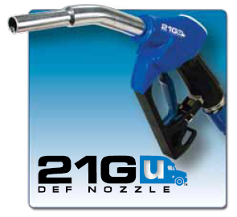
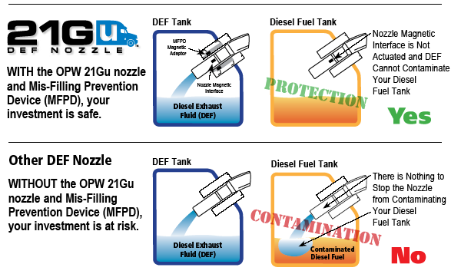


21Gu™ Diesel Exhaust Fluid Hanging Hardware - Nozzles
The world’s first DEF nozzle with Mis-Filling Prevention (ISO 22241 Standard)
All nozzles come with integrated filter, and DEF Identification Badge

Slide 12
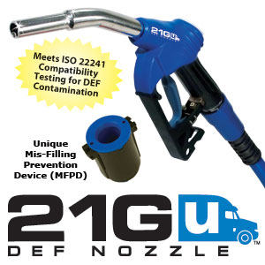

Diesel Exhaust Fluid (DEF)
Truck manufacturers specify OPW Mis-Filling Prevention Device (MFPD) or equivalent
  PACCAR Brands
  Daimler Trucks N.A. Brands
  Volvo Trucks N.A. Brands
  Nissan Trucks N.A. Brands
New items
  Nozzles without MFPD as an option (21GU-0400 & 0400G series)
  OPW cuts/couples DEF hose to length, and sells hose in bulk

Slide 13
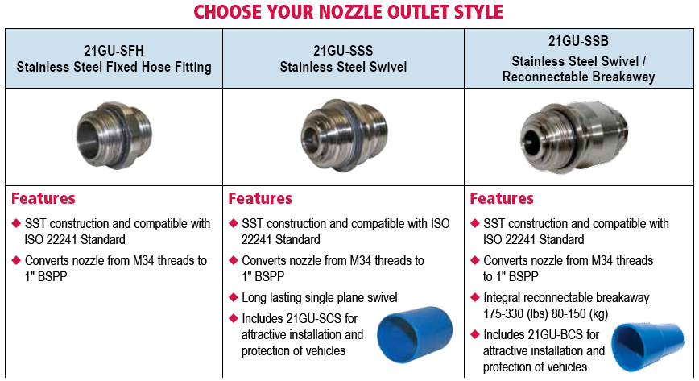
21Gu™ DEF Hanging Hardware – Swivels and Breakaways
For every nozzle ordered, one adaptor is required

Slide 14
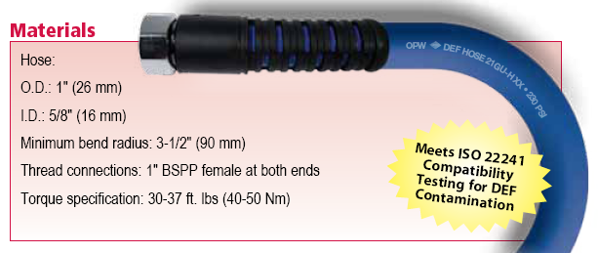
21Gu™ DEF Hanging Hardware - Hose
Comes with Integrated Anti-Kinking Sleeve

Slide 15
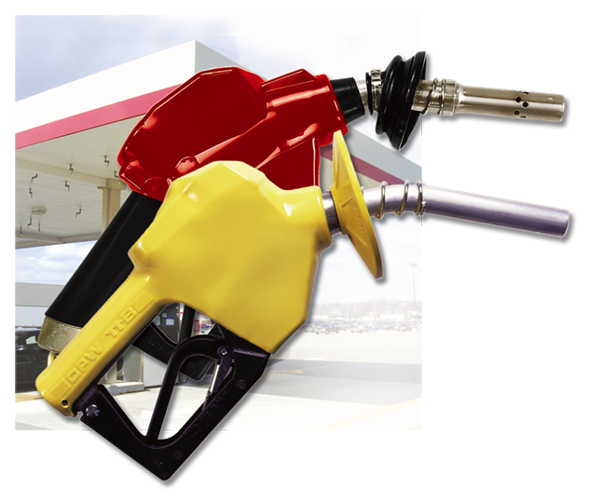
OPW Automatic Nozzles
Why Are
These Nozzles
Found in More Locations Than Any Other…

Slide 16
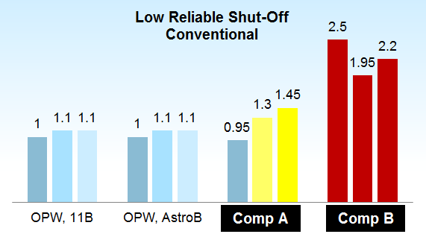
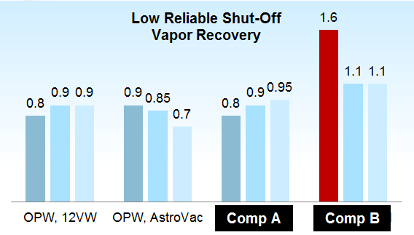
Low Flow Reliable Shut-Off
Most common root cause of automatic nozzle failure = Low Flow Rates
Industry flow rate standard 5-10 gpm
OPW low flow reliable shut-off standard (new) 1.5 gpm, (field) 3.0 gpm
Increased Low Reliable Shut-Off rates = Increased chances of a Non-Shut-Off event
Increase safety of your fueling operations with OPW nozzles

Slide 17
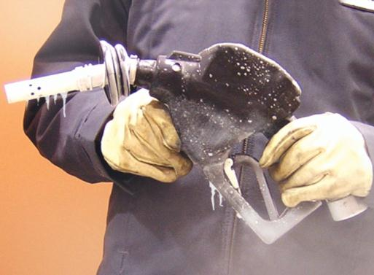
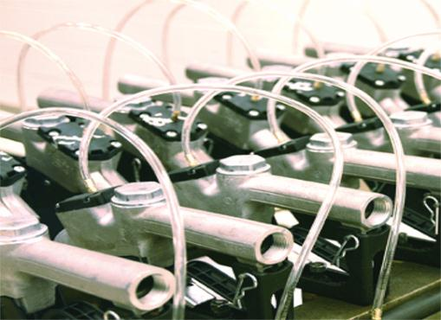
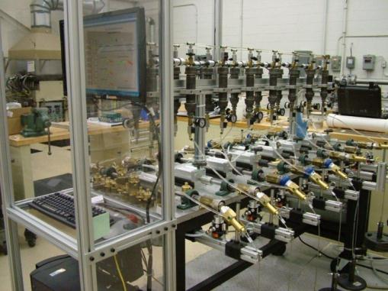
Superior Testing and Engineering
We’ll go to any extreme to ensure the highest degree of quality.
Industry’s largest and most sophisticated test laboratory

Slide 18
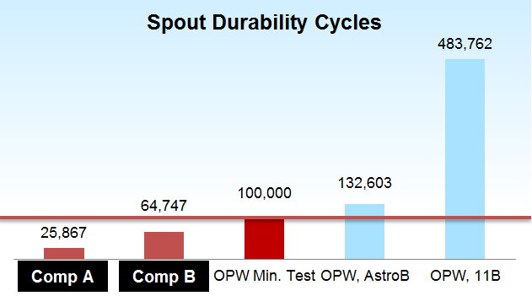
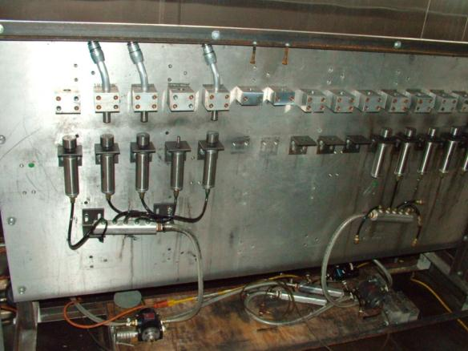
Spout Durability
Non-SST spout on OPW Astro Series
New SST tip spout on OPW 11 Series
Increases expected life of spout by 4X
Increased spout durability = less replacement costs & downtime
Reduce your annual maintenance costs and downtime with OPW Nozzles

Slide 19
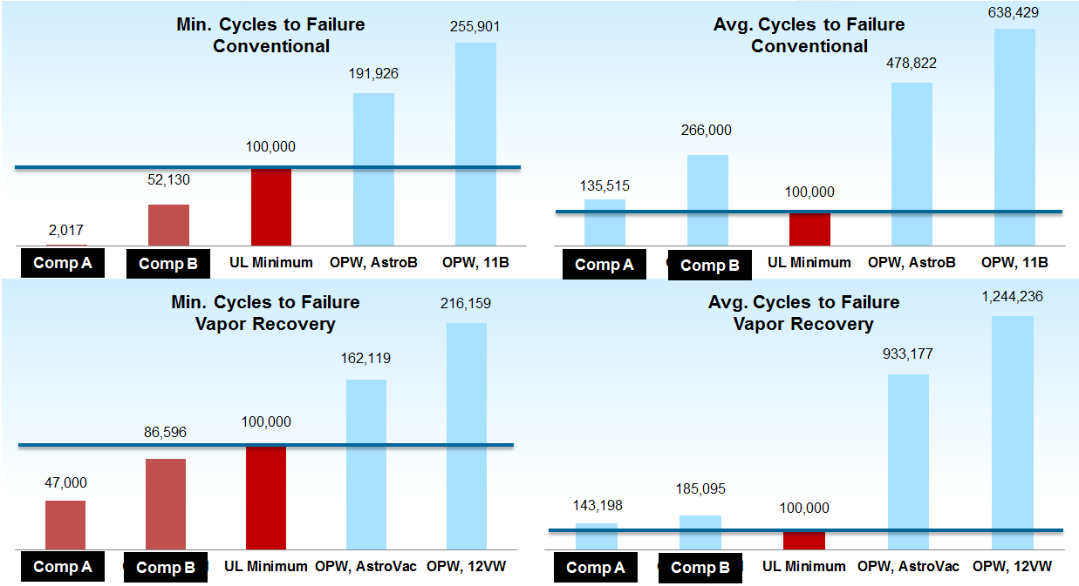
Durability – Life Cycle Testing

Slide 20
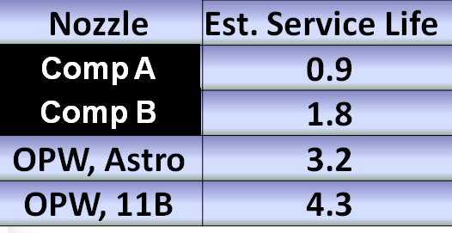
Durability, Life Cycle Testing – Practical Approach
3M gallons / year over 12 nozzles
250,000 gallons / year per nozzle
  10 gal. avg. fill-ups
25,000 fill-ups / year
150,000 auto shutoffs / year*
UL minimum = 100,000 cycles
*Assumes five (5) top-offs after initial automatic shutoff and no significant customer abuse (ex. drive-offs)
Reduce your annual maintenance costs & downtime with OPW Nozzles
Notes:
Add percentages of service life

Slide 21
Simply the Best Nozzle
…No Other Nozzles
Compare To OPW For:
End User Experience
In Use Performance
Engineering & Testing
Quality & Reliability

Slide 22

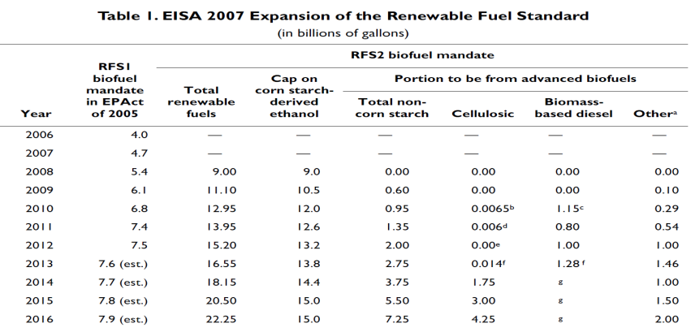
Renewable Fuels Standard (RFS)
Under the Energy Independence and Security Act (EISA) of 2007, the Renewable Fuel Standard was expanded in several key ways:
  EISA expanded the RFS program to include diesel, in addition to gasoline;
  EISA increased the volume of renewable fuel required to be blended into transportation fuel from 15.2 billion gallons in 2012 to 36 billion gallons by 2022
  EISA established new categories of renewable fuel, and set separate volume requirements for each one.

Slide 23






Resource Information Available
U.S. Environmental Protection Agency
  http://www.epa.gov/otaq/fuels/renewablefuels/regulations.htm
National Ethanol Vehicle Coalition
  www.e85fuel.com
Renewable Fuels Association
  www.ethanolrfa.org
American Coalition for Ethanol
  www.ethanol.org
U.S. Department of Energy
  www.eere.energy.gov/afdc/
National Biodiesel Board
  www.biodiesel.org

Slide 24
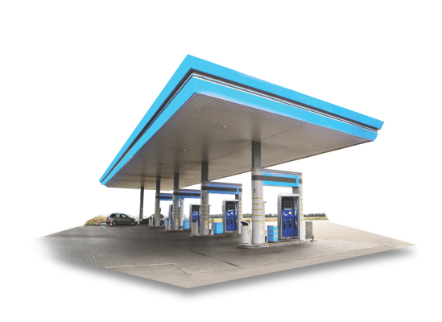
Regulation Changes – Vapor Recovery
In May 2012, the EPA determined that the use of onboard refueling vapor recovery (ORVR) for capturing gasoline vapor was in widespread use.
  In order to phase out existing Stage II programs in SIPs, states would need to submit SIP revisions to EPA meeting applicable CAA requirements and receive approval from the EPA.
Eighteen states currently do not require any form of Stage II Vapor Recovery at GDFs. They are:
  Alabama
  Alaska
  Arkansas
  Colorado
  Hawaii
  Idaho
  Iowa
  Kansas
  Minnesota
  Mississippi
  Montana
  Nebraska
  North Dakota
  South Carolina
  South Dakota
  Utah
  West Virginia
  Wyoming

Slide 25
Regulation Changes – Vapor Recovery
Tennessee
  No plans for decommissioning at this time.
  End users may submit a variance request that will allow them to
    Build a new site w/o Stage II
    Not install Stage II when doing major modifications
  This variance request must be resubmitted annually.
All stats as of 8.1.13
Notes:
In May 2012, the EPA determined that the use of onboard refueling vapor recovery (ORVR) for capturing gasoline vapor was in widespread use.
In order to phase out existing Stage II programs in SIPs, states would need to submit SIP revisions to EPA meeting applicable CAA requirements and receive approval from the EPA.
Tennessee
No plans for decommissioning at this time.
End users may submit a variance request that will allow them to
Build a new site w/o Stage II
Not install Stage II when doing major modifications
This variance request must be resubmitted annually.

Slide 26
Regulation Changes – Vapor Recovery
Georgia
  GAEDP is currently discussing a repeal of the Stage II rule.
  A repeal would simply allow the end user to do whatever they want, whenever they want.
  Georgia Tank and Equipment Contractors (GTEC) has submitted formal comments recommending that GAEPD impose an organized decommissioning. The process would use the decommissioning practices recommended in PEI’s RP300. This would also mirror the actions of many other States.
  End users building new sites or with major modifications may request a variance in lieu of Stage II.
All stats as of 8.1.13

Slide 27
Regulation Changes – Vapor Recovery
Missouri –
  The Department of Natural Resources’ Air Pollution Control Program is announcing that, beginning no sooner than March 15, 2013, gasoline stations in the St. Louis area subject to Stage II Vapor Recovery Rules may begin to decommission their Stage II Vapor Recovery Equipment, following proper procedures
Illinois –
  Has not waived Stage II Vapor Recovery requirements for the counties surrounding Chicago metropolitan area. Changes to Illinois rules are scheduled to take effect Jan. 1, 2014
Indiana -
  Has not waived Stage II Vapor Recovery rules, which cover the Gary, IN, metropolitan area
All stats as of 8.1.13

Slide 28
Regulation Changes – Vapor Recovery
Wisconsin -
  Has begun allowing stations to decommission their stage II vapor recovery systems
Kentucky –
  Has not waived Stage II Vapor Recovery requirements for GDFs in the Jefferson County and Northern Kentucky regions
Ohio -
  Has not waived Stage II Vapor Recovery requirements in effect for the Cleveland-Akron, Cincinnati and Dayton area. However, the Ohio EPA is working to waive the requirements
All stats as of 8.1.13

Slide 29
Regulation Changes – Vapor Recovery
Maine –
    Has waived Stage II Vapor Recovery requirements for GDFs as of Jan. 1, 2012, and all existing systems must be decommissioned by Jan. 1, 2013. Find more information at: www.maine.gov
New Hampshire –
  Has waived Stage II Vapor Recovery requirements for GDFs as of Jan. 1, 2012, and all existing systems in the state must be decommissioned by December 22, 2015. Find more information at: www.des.nh.us
Vermont –
  Has waived Stage II Vapor Recovery requirements for GDFs as of Jan. 1, 2013, and all systems must be properly decommissioned by Jan. 15, 2015. Find more information at: www.anr.state.vt.us
Connecticut –
  Has waived Stage II Vapor Recovery requirements for GDFs as of Feb. 12, 2012. Find more information at: www.ct.gov
All stats as of 8.1.13

Slide 30
Regulation Changes – Vapor Recovery
Pennsylvania –
  Has waived Stage II Vapor Recovery requirements for new GDFs as of July 31, 2012. The Department will continue to enforce the requirements applicable to existing facilities subject to the Stage II requirements until further notice. Find more information at: www.pabulletin.com
Massachusetts –
  Has waived Stage II Vapor Recovery requirements at new GDF’s and existing GDF’s as of July 9, 2012. GDF’s with existing Stage II Vapor Recovery requirements can begin decommissioning following proper procedures. Find more information at: www.mass.gov
New York –
  Has waived Stage II Vapor Recovery requirements for GDFs as of Jan. 1, 2011. GDF’s with existing Stage II Vapor Recovery requirements can begin decommissioning following proper procedures. GDFs equipped with Stage II systems that are not decommissioned must continue to comply with existing Stage II requirements. Find more information at: www.dec.ny.gov
All stats as of 8.1.13

Slide 31
Regulation Changes – Vapor Recovery
Maryland –
  Has not waived Stage II Vapor Recovery requirements for GDFs. Stakeholder meetings began being held in 2012 with the primary purpose of amending the Stage II requirements for new and rebuilt gasoline stations.
  Find more information at: www.dsd.state.md.us
New Jersey –
  Has not waived Stage II Vapor Recovery requirements for GDFs . Find more information at: www.state.nj.us
Delaware –
  Has not waived Stage II Vapor Recovery requirements for GDFs exceeding 10,000 gallons throughput. Find more information at: regulations.delaware.gov
Rhode Island –
  Has not waived Stage II Vapor Recovery requirements for GDFs that were constructed or substantially modified after Nov. 15, 1992. Find more information at: www.dem.ri.gov
All stats as of 8.1.13

Slide 32
Regulation Changes – Vapor Recovery
Arizona -
  Arizona has not waived Stage II Vapor Recovery installation requirements. The Arizona Department of Weights and Measures will pursue a revision to allow decommissioning of Stage II Vapor Recovery equipment at GDF’s in the three-county area surrounding Phoenix no later than December 31, 2017. Find more information at: http://www.azdwm.gov
Louisiana -
  Stage II Vapor Recovery is still required in the six parishes surrounding Baton Rouge. The rule does not apply to segregated E85 dispensing systems that can only dispense to E85 vehicles.
  Find more information at: www.deq.louisiana.gov
Missouri -
  Missouri has waived Stage II Vapor Recovery requirements at GDF’s in the St. Louis area. Existing sites may begin to decommissioning their Stage II Vapor Recovery Equipment, following proper procedures.
  Find more information at: www.dnr.mo.gov
All stats as of 8.1.13

Slide 33
Regulation Changes – Vapor Recovery
New Mexico –
  Dona Ana County (Las Cruces, NM/El Paso, TX, area) is the only county that requires Stage II Vapor Recovery. Find more information at: www.nmenv.state.nm.us
Oklahoma -
  Has not waived Stage II Vapor Recovery requirements. Find more information at: www.deq.state.ok.us
Texas -
  The Texas Commission on Environmental Quality is exercising enforcement discretion for potential Stage II Vapor Recovery system violations in the areas of Houston-Galveston-Brazoria, El Paso, Dallas-Fort Worth and Beaumont-Port Arthur for any GDF under construction, any GDF that has not begun dispensing fuel, any GDF that becomes subject to State II requirements due to increased throughput. GDFs already equipped with State II Vapor Recovery Systems must continue to comply with existing requirements.
  Find more information at: http://www.tceq.texas.gov
All stats as of 8.1.13

Slide 34
Stage II Vapor Recovery Today
US Vapor Recovery Markets
All stats as of 8.1.13
Key:
Red VR Required
Yellow Dependent on Location/Throughput
Green VR Decommissioning in process
White VR has been decommissioned
Note: Only certain counties and/or stations based on gasoline throughput are required to be stage II in designated states. Consult each local state agency for additional information

Slide 35
Stage II Vapor Recovery Estimated 2014
US Vapor Recovery Markets
Key:
Red VR Required
Yellow Dependent on Location/Throughput
Green VR Decommissioning in process
White VR has been decommissioned
Note: Only certain counties and/or stations based on gasoline throughput are required to be stage II in designated states. Consult each local state agency for additional information
Notes:
Add 2015 transition

Slide 36
Stage II Vapor Recovery Estimated 2015
US Vapor Recovery Markets
Key:
Red VR Required
Yellow Dependent on Location/Throughput
Green VR Decommissioning in process
White VR has been decommissioned
Note: Only certain counties and/or stations based on gasoline throughput are required to be stage II in designated states. Consult each local state agency for additional information
Notes:
Add 2015 transition

Slide 37
Stage II Vapor Recovery Estimated 2016+
US Vapor Recovery Markets
Key:
Red VR Required
Yellow Dependent on Location/Throughput
Green VR Decommissioning in process
White VR has been decommissioned
Note: Only certain counties and/or stations based on gasoline throughput are required to be stage II in designated states. Consult each local state agency for additional information

Slide 38


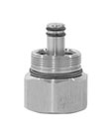
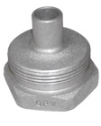
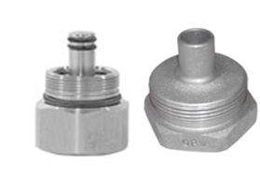
OPW Offers conVRsion Kits
PEI RP-300 (Rev. 09) Section 14 “Decommissioning Stage II Vapor-Recovery Piping”, Para. 14.6.9 states…
  “Replace all the Stage II hanging hardware with conventional hanging hardware. This applies to both balance and vacuum-assist hanging hardware…install an adaptor fitting to convert the fuel outlet to a non-vapor-recovery fitting.”
11B Nozzle
66REC Breakaway
45 Swivel
VR Adaptor
AstroB Nozzle
66V Breakaway
241TPS Swivel
VR Adaptor

Slide 39
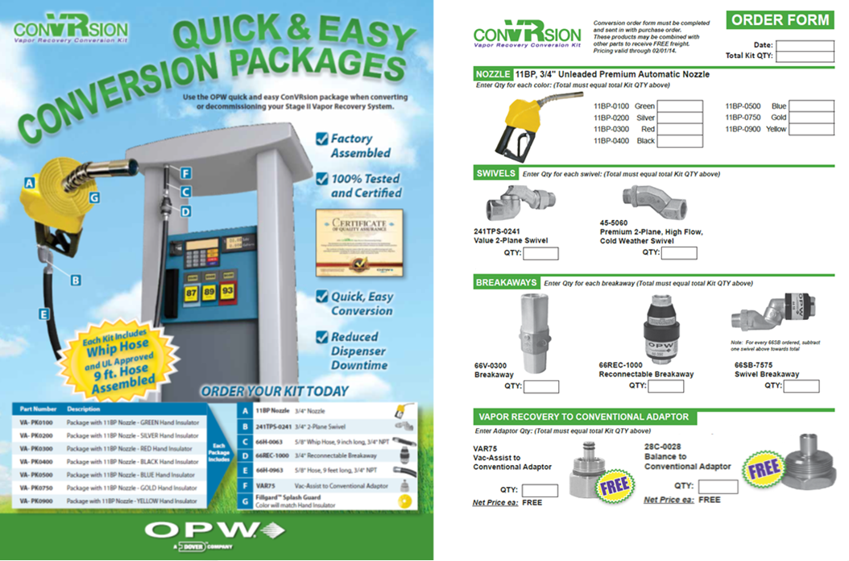
OPW Offers conVRsion Kits

Slide 40
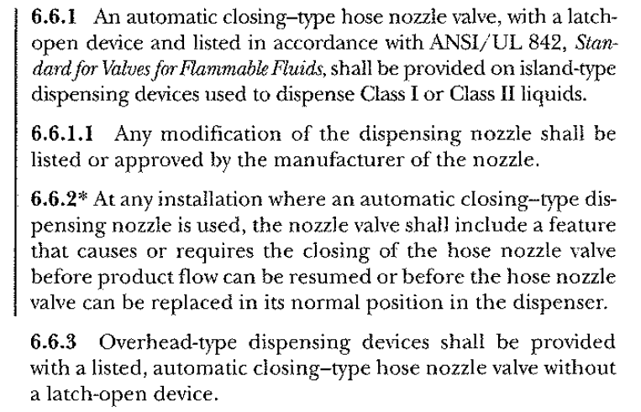
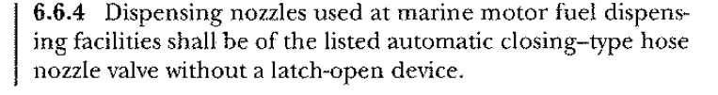
2012 NFPA 30/30A Changes are in Effect
A UL listed Nozzles with hold-open device for gasoline and diesel filling…
You may NOT remove the hold-open device in the field, or put it back on.
ONLY No Pressure No Flow Nozzles (B Style nozzles ONLY)
Overhead filling devices may not have hold open devices unless they are B-Style nozzles (Example: Lube bays, Jiffy Lube)
Marinas are NOT allowed to have hold open devices.
OPW recommends that only nozzles with no pressure-no flow devices be installed at any location where applicable.

Slide 41
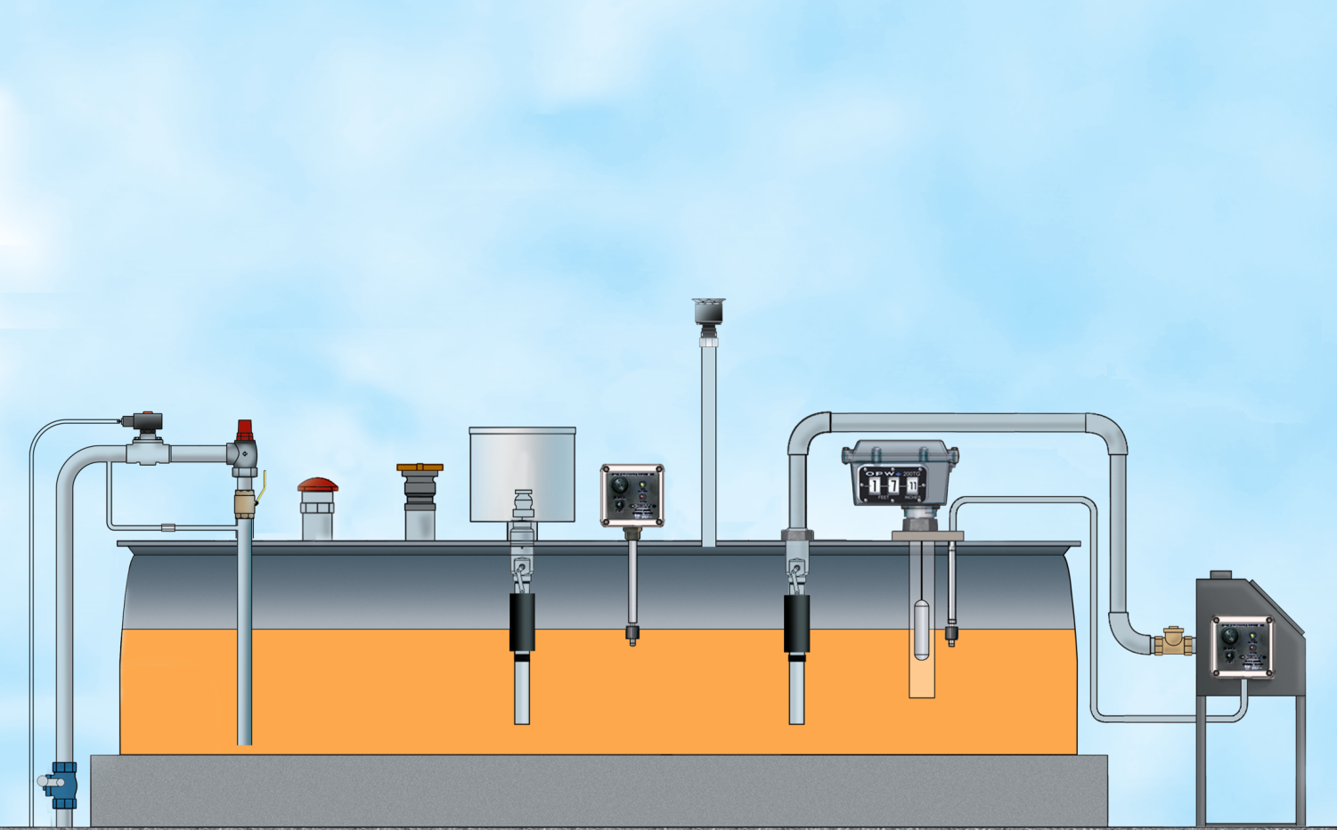

The First CARB-Certified AST Phase I EVR System in the Industry
CARB-Certified OPW AST Phase I EVR products ensure that you are provided
unmatched environmental protection, durability and longer-life performance
199ASV
Anti-Siphon Valve
1711T /1711LPC
Vapor Recovery Cap
331/332 AST
Spill Container
523 and 623
Pressure
Vacuum Vent
200TG
Mechanical
Tank Gauge
821 Solenoid Valve
301 Emergency
Vent Valve
211-RMOT Remote-Fill Above Ground Storage Tank Spill Container
82RV
Valve
61VSA Rotatable
Swivel Adaptor
21BV Full Port
Two-Way Ball Valve
1611/1612 Kamvalok® Poppeted Adaptor
144TA and 444TA AST Tank Alarms
175 / 1175
Swing Check Valve
61fstop Overfill Prevention Valve
178S Emergency
Shut-off Valve

Slide 42
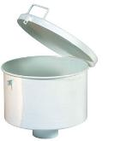
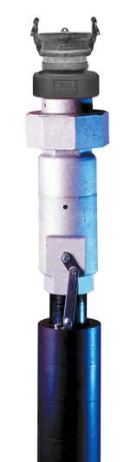
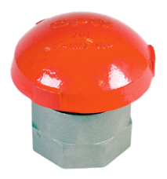
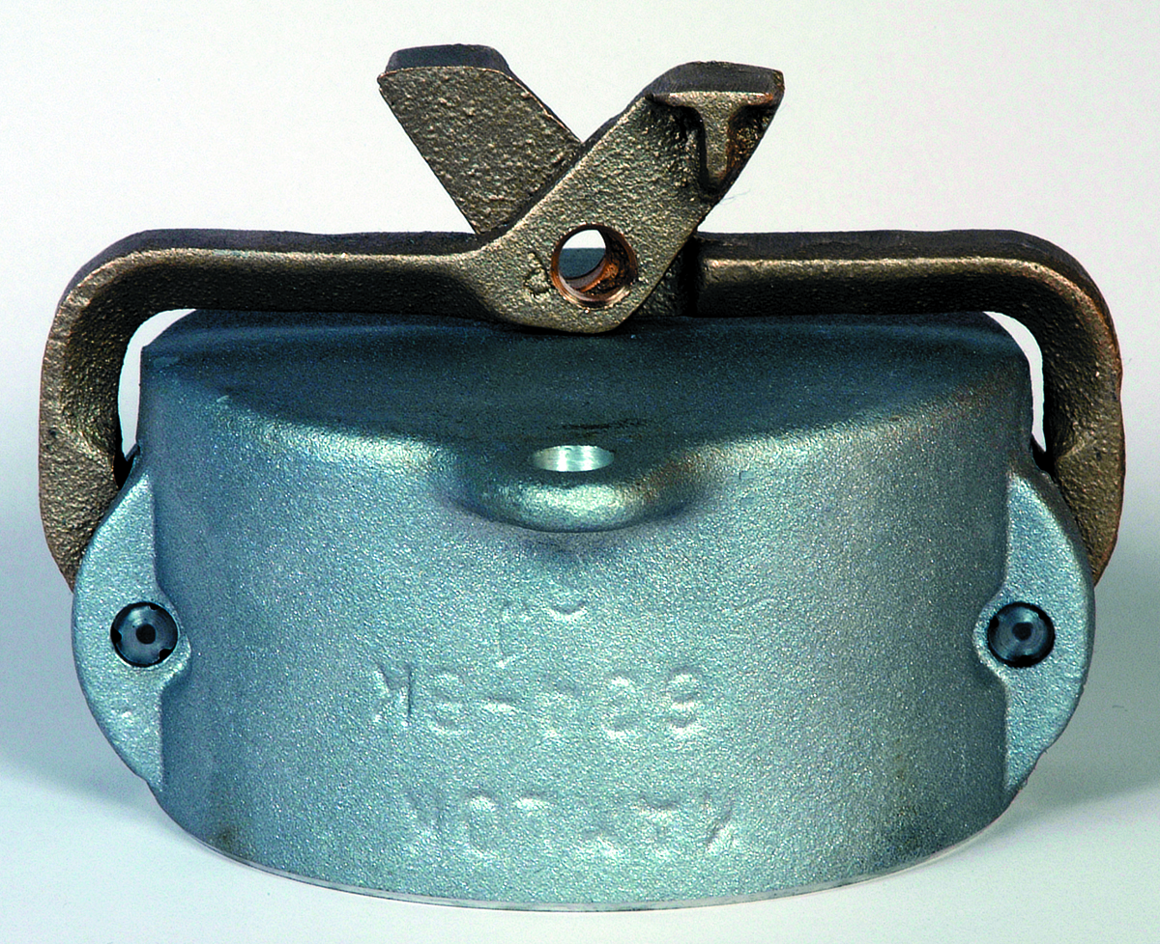
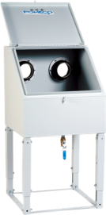
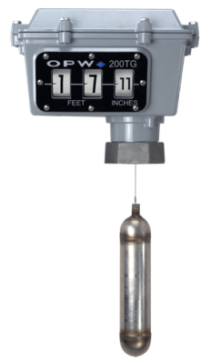
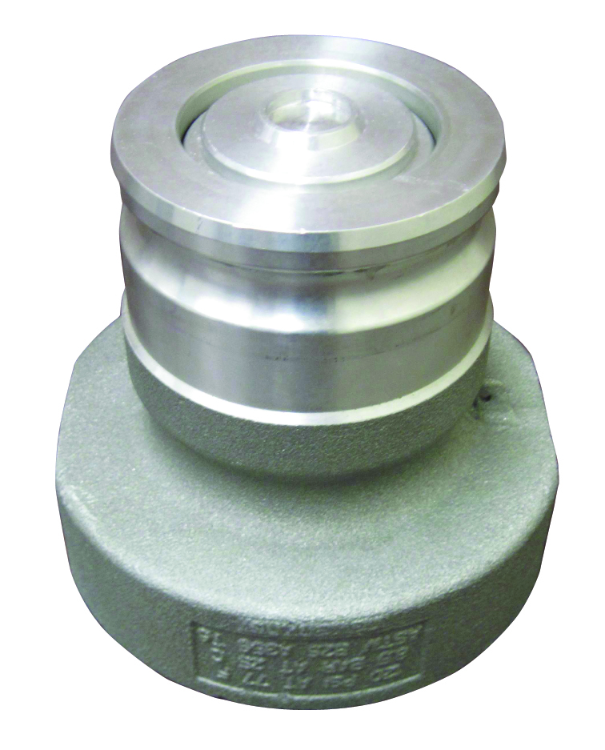







Above Ground Storage Tank Product requirements
Required for NFPA-30A
Vapor-tight emergency vent
Overfill protection
  Audible alarm
  Automatically stop flow
Liquid level determination
Siphon flow release prevention
Shutoff and check valves with pressure-relieving device
  Quick-connect coupling
  Check valve with dry-break coupling
Accurate daily inventory
Tanks filled through liquid tight connection
Tamper-proof / physical damage protection

Slide 43
Above Ground Storage Tank Product requirements
Required for PEI/RP-200-13
Fire valve at tank opening
Block valve @ each connection where product normally flows
Anti-siphon valve
Suction pumping systems - check valve
Pressure relief for piping subjected to thermal expansion

Slide 44



301 & 202 Series Emergency Vents
OPW Emergency Vents prevent above ground storage tanks from becoming over-pressurized by providing high-capacity venting in the event of a fire or sudden pressure increase
301 is a weighted, mushroom-style emergency vent that automatically resets. The unique vapor seal & stainless steel plate = zero emissions
The 202 is a vapor-tight, spring-loaded emergency vent that has a manual reset feature
301
Emergency
Vent
202
Emergency
Vent

Slide 45




61ƒSTOP “THE STOPPER” Overfill Prevention Valves
The OPW 61ƒSTOP (“The Stopper”) prevents overfilling by providing positive shut-off during a pressurized-fill (pump-on fill) delivery
Available for direct or remote fill
Integral Anti-Siphon valve isolates tank from leaking fill pipe
No pre-checks to perform, no resets or overrides
150 PSI pressure rated, low pressure drop = fastest fill rates
61ƒSTOP Overfill Prevention Valve
61FT Drop Tube

Slide 46







AST Direct-Fill Application
1
2
3
1
1711D Series
Kamvalok® Couplers
2
3
634B Series
Dust Caps
1611AN or 1612AN Series
Direct Fill Kamvalok® Adaptors –
2” or 3”
4
5
4
5
6
331 and 332 AST Direct-Fill Spill Container
61ƒSTOP
Overfill Prevention Valves
61FT Drop Tube
6

Slide 47


Overfill Valve Comparison
OPW 61FSTOP | Competitor A Overfill Valve | OPW Advantage
Shutoff is activated by a cam that is rotated mechanically | Shutoff is activated by hydraulic principle | Better Performance Longer life Gravity Drop OK
Closes with the flow | Closes against flow | Fail-Safe
Can be used in gravity drop applications (25gpm minimum) | Pressure is required to operate | Broader Application

Slide 48




200TG Mechanical Tank Gauge
For easy reading of liquid levels in above ground storage tanks
Provides accurate numerical counter readout, eliminating the need for any on-site manual gauging (sticking)
Vapor Tight – Allows for standard tank pressure testing, sealing up to 25-psig (1.72 bar)
Available for tanks up to 40 feet depth
English or Metric unit readouts

Slide 49


Mechanical Tank Gauge Comparison
OPW 200TG Mechanical Tank Gauge | Competitor A Mechanical Tank Gauge | OPW Advantage
UL listed | No 3rd party listing | No risk 100% Compliance
Vapor tight to 25 psi (Lab tested 50 psi !) | Vapor tight to 5 psi | Less Fugitive Emission
Large contrasting numbers & ergonomic tilted face | Flat “Clock” style | Intuitive to read Better Visibility Ultimate Contrast
Depths to 40 feet | Depths to 12 feet | Larger Served Market
Please tell me what my tank level is at 3:45 !

Slide 50



144TA & 444TA AST Tank Alarms
Sense up to four different liquid levels or other signals using just one device.
  High / Low liquid level
  Interstitial monitoring
  One tank or four separate tanks
Audible Alarm – 90-decibels
Visual – Red alarm light flashes
Intrinsically Safe – Complies with ANSI/UL 913 for Class 1, Division 1 & 2 for Groups C & D hazardous locations
Remote - up to 1,000 feet away or direct on top of tank
444TA
144TA

Slide 51









Industrial Nozzles
295 Series
S = Swivel
C = Check Valve
A = Aviation Fuel
J = Jet Fuel
F = Flanged Nozzle
 | OPW 1290 | OPW 190 | OPW 210 | OPW 295SC | OPW 295SAJ | OPW 295SA | OPW 295AF | OPW RF400
Automatic Shutoff
Dual Poppet
Adj. Dash Pot
Built –In Swivel
Built-In Check Valve
Aviation Fuel
Fuel Oil

Slide 52

Industrial Nozzles
OPW 1290
Automatic Shut-Off Nozzles
For Heavy-Duty, High-Flow
Truck, Bus and Home Fuel Oil Delivery Service
Venturi-Type Shut-Off Mechanism – for automatic shut-off.
Aluminum Body – lighter in weight and easier to maneuver than other nozzles on the market.
^{Two-position hold-open device.}
One-Hand Control of Hold-Open Mechanism – means easy setting of flow rate.
Right Angle Design – provides larger lever area for better grips and easier control, permitting the nozzle to fit into awkward spaces close to walls and into corners.
Easily-Replaced Spout – simply remove the spout retainer nut.
Built-In Outlet Check Valve – meets all known requirements of the Division of Measurement Standards.
Dual Poppets – make nozzle easy to open against high inlet pressure.
Design working pressure – 50 psi (3.45 bar) maximum pressure.

Slide 53

Industrial Nozzles
^{OPW 295SC High-Flow Nozzles}
For High-Flow, Bulk Fuel Oil Delivery Service
Aluminum Body – lighter weight, easier to maneuver.
Dual Poppets – easy-to-open nozzle against high inlet pressures.
Replacement Hold-Open Rack – one-hand control of hold-open mechanism means easy setting of flow speed. Nozzle must be attended at all times during usage.
Replaceable Composite Lever Guard – easy, low-cost replacement.
Right Angle Design – provides larger lever area for better grip and easier control; permits nozzle to fit into awkward spaces close to walls and into corners.
Adjustable Dash Pot – permits adjusting the main poppet closure rate over a wide range of flows to overcome line shock with minimum after flow.
Built-In Swivel – eliminates twisting and kinking of the hose. This swivel is hard-coated aluminum and has full-bearing surfaces.
Built-In Check Valve – prevents hose drainage after pump is turned off.
Vinyl-Coated Lever – insulates fingers against cold.
Easily Replaced Spout – the spout is easily threaded into the body. Replacement spouts are readily available from OPW.
NPT Female Threads at Inlet End – standard pipe threads accept all 11/4" or 11/2" male connections.
Design working pressure 50 psi (3.45 bar) maximum pressure

Slide 54

Industrial Nozzles
^{OPW 190 High-Flow Nozzles}
For High-Flow, Bulk Fuel Oil Delivery Service
Designed to handle high flow when line pressure is not a critical consideration or otherwise absorbed.
Aluminum Body – lighter weight, easier to maneuver.
Dual Poppets – allow for low flow metering (this nozzle is not intended for high pressure pump applications).
Replaceable Hold-Open Rack – for use when fueling large-capacity tanks. Nozzle must be attended at all times during usage.
Right Angle Design – provides larger lever area for better grip and easier control; permits nozzle to fit into awkward spaces close to walls and into corners.
Drag Lugs – protect the nozzle when dragged across rough surfaces; enhances long-life durability.
Easily Replaced Spout – the spout is easily threaded into the body. Replacement spouts are readily available from OPW.
NPT Female Threads at Inlet End –standard pipe threads accept all standard 1", 11/4", 11/2" and 2" male connections.
Design working pressure 50 psi (3.45 bar) maximum pressure

Slide 55

Industrial Nozzles
^{OPW 210 High-Flow Nozzles}
For High-Flow, Bulk Fuel Oil Delivery Service
Aluminum Body – lighter weight, easier to maneuver.
Dual Poppets – allows for low-flow metering.
Replaceable Hold-Open Rack – for use when fueling large-capacity tanks. Nozzle must be attended at all times during usage.
Dash Pot – non-adjustable, to minimize closing line shock.
Right Angle Design – provides larger lever area for better grip and easier control; permits nozzle to fit into awkward spaces close to walls and into corners.
Drag Lugs – protect the nozzle when dragged across rough surfaces; adds to long life with rough usage.
Easily Replaced Spout – the spout is simply threaded into the body. Replacement spouts are readily available from OPW.
NPT Female Threads at Inlet End – standard pipe threads accept all standard 1¼" and 1 ½" male connections.
Design working pressure - 50 psi (3.45 bar) maximum pressure

Slide 56


Industrial Nozzles
^{OPW 295SA & SAJ}
^{Aircraft Nozzles}
^{For Overwing Aircraft Service}
^{For Heavy-Duty, High-Flow}
Truck, Bus and Home Fuel Oil Delivery Service
^{295SAJ-0200}
Aluminum Body – lighter weight, easier to maneuver.
Dual Poppets – easy-to-open nozzle against high inlet pressures.
Color-Coded Composite Lever Guards – helps distinguish between AVGAS and Jet A.
Easily replaced in lever guard kit.
Right Angle Design – provides larger lever area for better grip and easier control.
100 Mesh Strainer – prevents foreign matter from entering fuel tank; easy to remove and clean.
Dust Cap – keeps spout free from dirt and stops fuel drippage when connected.
Adjustable Dash Pot – permits adjusting the main poppet closure rate over a wide range of flows to overcome line shock with minimum afterflow.
Built-In Swivel – eliminates twisting and kinking of the hose. This swivel
is electroless nickel-plated and has full-bearing surfaces.
NPT Female Threads at Inlet End of 295SA – accepts all 1", 11/4” or 11/2" male connections.
NPT Female Threads At Inlet End Of 295SAJ – accepts all 11/2" male connections.
Unique Jet Aircraft Spout Design of 295SAJ – to help prevent inadvertent fueling of piston engine aircraft with turbine fuel.
Ground Wire Assembly – included on all aviation nozzles.
Design working pressure 50 psi (3.45 bar) maximum pressure
^{295SA-0135}

Slide 57

Industrial Nozzles
^{OPW 295AF}
^{Aircraft Nozzles}
^{For Over Wing Aircraft Service}
Aluminum Body – lighter weight, easier to maneuver.
Dual Poppets – easy-to-open nozzle against high inlet pressures.
Replaceable Lever Guard – easy, low-cost replacement.
Right Angle Design – provides larger lever area for better grip and easier control.
Vinyl-Coated Lever – insulates fingers against cold.
100 Mesh Strainer – prevents foreign matter from entering fuel tank; easy to remove and clean.
Dust Cap – keeps spout free from dirt and stops fuel drippage when connected.
Spout Protector Ring – to protect aircraft tanks and wing surface; adjustable. Furnished as standard.
Special Heavy-Duty Spout – knurled to facilitate daily strainer service.
NPT Female Threads at Inlet End - standard pipe threads all 11/2" male connections.
Static Ground Wire – with air force plug meets MS 25384-5.
Dash-Pot Action – for smoother closing action and reduced line shock.
Design working pressure 50 psi (3.45 bar) maximum pressure

Slide 58

Industrial Nozzles
OPW RF-400 Manual
Utility Farm Nozzle
^{For General Utility Farm Usage}
The OPW RF400 nozzle is designed for use in non retail, commercial, industrial and agriculture use where an automatic nozzle is not needed.
UL listed for use in gasoline, diesel and up to 10% ethanol blends.
Manual Nozzle – no automatic shut-off.
Built in hanger for quick use in field.
Design working pressure 50 psi (3.45 bar) maximum pressure

Slide 59










Industrial Nozzle Accessories

