Slide 1
Below Ground Products
2013 Distributor Meeting

Slide 2
Agenda
The Center Of The Underground Universe
    Regulations, the driving force
    The environmental evolution
    UL Listed FlexWorks
    Piping & Fittings
    Entry Fittings: Flexible and Rigid
    Tank & Dispenser Sumps
    The FlexWorks Loop System

Slide 3

EPA Proposed Revision to the 1988 UST Regulations
(40 CFR part 280)

Slide 4

EPA Proposed Revisions
The US EPA is proposing revisions to strengthen the 1988 federal underground storage tank (UST) regulations by:
Increasing emphasis on properly operating and maintaining UST equipment. These revisions will help improve prevention and detection of UST releases, which are one of the leading sources of groundwater contamination.
Help ensure all USTs in the United States, including those in Indian country, meet the same minimum standards. This is the first time EPA is proposing significant revisions to the federal UST regulations since they were first promulgated in 1988.

Slide 5
EPA Proposed Revisions (40 CFR part 280)
Adding secondary containment requirements for new and replaced tanks and piping
Adding operator training requirements for UST system owners and operators
Adding periodic operation and maintenance requirements for UST systems
Removing certain deferrals
Adding new release prevention and detection technologies
Updating codes of practice
Making editorial and technical corrections
Eliminating flow restrictors in vent lines as an option for owners and operators to meet the overfill prevention equipment requirement for newly-installed UST systems and when flow restrictors in vent lines are replaced

Slide 6
US EPA and 40 CFR
November 18, 2011: The EPA proposed revisions to the 1988 federal UST regulations.
April 16, 2012: The 150-day comment period ended.
191 PEI affiliates made comments and here is what they said…

Slide 7
Summary of PEI Member Comments to EPA Update
Increase time intervals for inspections and testing
Align testing intervals for Spill Containment and Overfill Valves
Allow sensors to replace sump inspection requirements
Are existing sites exempt prior to a commissioning date?
How not to punish proactive companies who installed secondary containment early. If secondary fails, can system be held to single wall requirements?

Slide 8
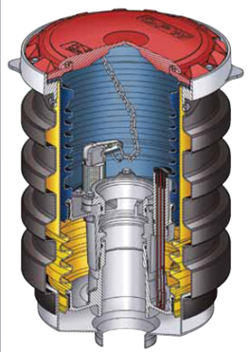
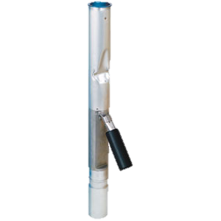
New EPA Requirements / PEI RP1200
What’s Coming :
Piping & Containment Systems
    Periodic Testing of Interstitial Space
    Or Continuous Monitoring
    Periodic Inspection/Integrity Testing of Sumps
Spill Containment
    Periodic Testing of Spill Containers
    Double Wall Spill Containers
Overfill Protection
    Vapor Tight OPV (40CFR)
    Elimination of Ball Floats as an overfill prevention method
    Periodic Inspection of Flapper Valves

Slide 9
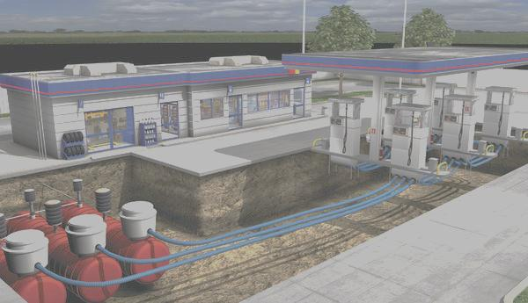
All Access – Able All The Time
Always:
Access – Able
Monitor – Able
Maintain – Able
Repair – Able
Replace – Able
WITHOUT BREAKING CONCRETE

Slide 10

Environmental Products
Valves & Fittings

Slide 11
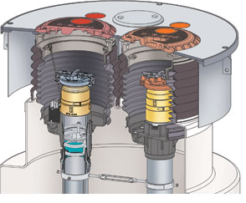
Spill Container Solution
Previous Generation Solution
Next Generation Solution
Slip-on Spill Containers
Non-Grade Replaceable Bellows
Inflexible Metal Containers
EDGE Series Spill Containment
Replaceable Containment Cartridges from Grade
Built in ports for easy interstitial testing
Upgradeable from Single to Double Wall Protection
Multi-Port Spill Containment
EVR Compliant for new builds
DW protection to top of the tank
Industry Developments
40 CFR Requiring Spill Containment at
Vapor Recovery
EPA requiring annual testing of spill containment for liquid tightness in 2013
More Regional EPA requiring Double Wall spill containment
Customers demanding grade replaceable systems, never have to break concrete again

Slide 12
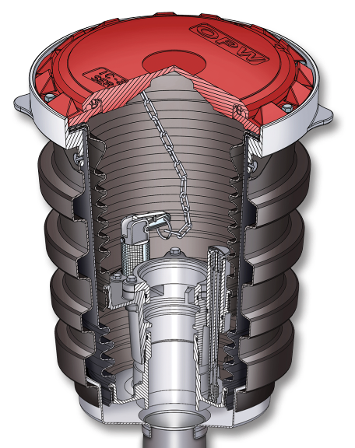
THE EDGE BUCKET - UNIQUE FEATURES:
Dimensionally identical in height from riser to grade as single wall buckets (16-17/32")
Can be used on 16.7" centers
Patent-pending ledge design - no face seal adaptor required
Superior thread-on base design
Corrosion-resistant
polyethylene skirt
Unique concrete ring design

Slide 13
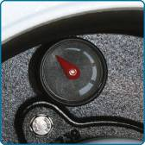
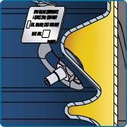
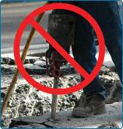
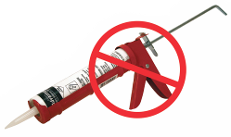
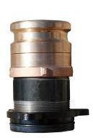
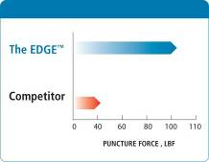
UNIQUE FEATURES CONTINUED
Convenient visual gauge for easy liquid level verification
Completely vacuum-testable from the top of bucket
No need to break concrete
Integral seals on both primary and secondary buckets - no messy sealants required
Patent-pending nipple adaptor - allows for use of standard socket wrenches
Superior puncture resistance

Slide 14


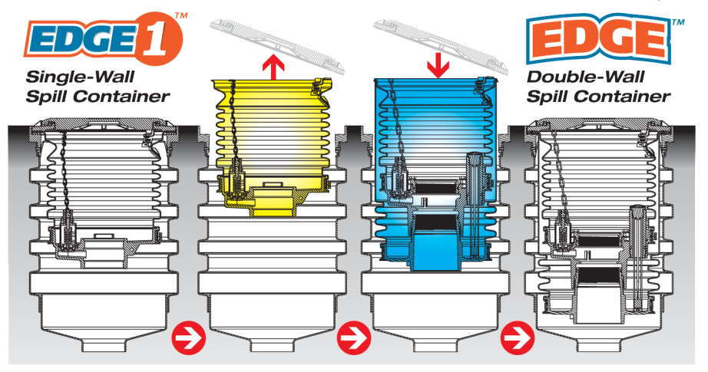
EDGE 1 SINGLE WALL ALSO AVAILABLE
Upgradeable to a
Double-Wall Bucket

Slide 15
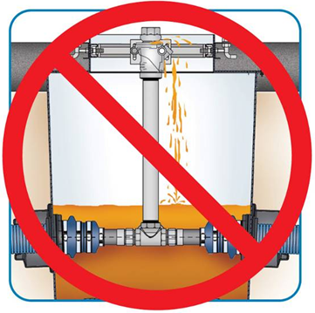
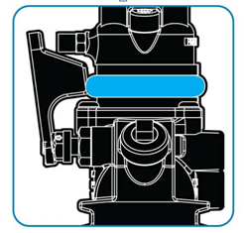
Nuisance Leak Solution
Previous Generation Solution
Next Generation Solution
Dispenser bump causes crack in shear groove, but does not separate valve to shut off flow
Nuisance break slowly releases product into dispenser sump, sets off leak detection alarm (hopefully)
Site shuts down, valve needs replaced, and product must be recovered
10 Plus
Sealed bladder around groove expands with fluid
Bladder trips shut-off mechanism, stopping product flow to dispenser
Leaked product is contained in valve mechanism
No released product in sump, no costly cleanup!
Industry Developments
Customers recognizing health, environmental contamination and fire risks associated with nuisance breaks

Slide 16
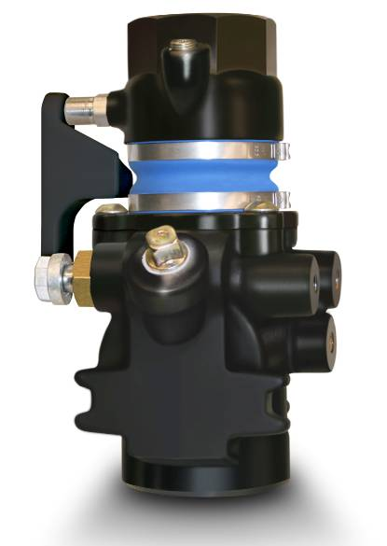

10 PLUS - A HIGHER LEVEL OF PROTECTION
The highest level of protection and peace-of-mind in the industry against:
  Low-Impact Breaks
  Dislodged Dispensers
  Dispenser Sump Fires

Slide 17
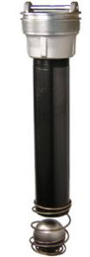


Overfill Prevention Solution
Previous Generation Solution
Next Generation Solution
Ball Floats as Primary Device
Non Vapor Tight Valves
Vertical Float Valves as Sustainable Solution
71SO Vapor Tight OFPV
Only solution with swing arm float technology
Provides reliable vapor tightness for years of use
Field adjustable at installation for local regulatory requirements
Available in Remote, Co-Axial, and High Alcohol Content
Industry Changes
40 CFR Requiring Vapor Tight and Functional Testing Every 3 Years
EPA Disallowing Ball Floats as primary overfill prevention device in 2013

Slide 18
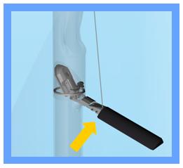

Product Overview and Competitive Selling: Environmental Products
Overflow Prevention Valves: Testable Feature
New Product Launched in October 2012
Allows Overflow Valve to be functionally tested without removing from the ground:
  Simple test avoids an hour of removal and reinstallation time for 2 contractors
  Eliminates opportunity to damage float mechanism and critical seals for vapor tightness
In process of gaining EVR and DEQ approvals

Slide 19
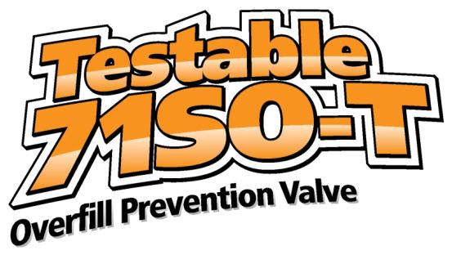
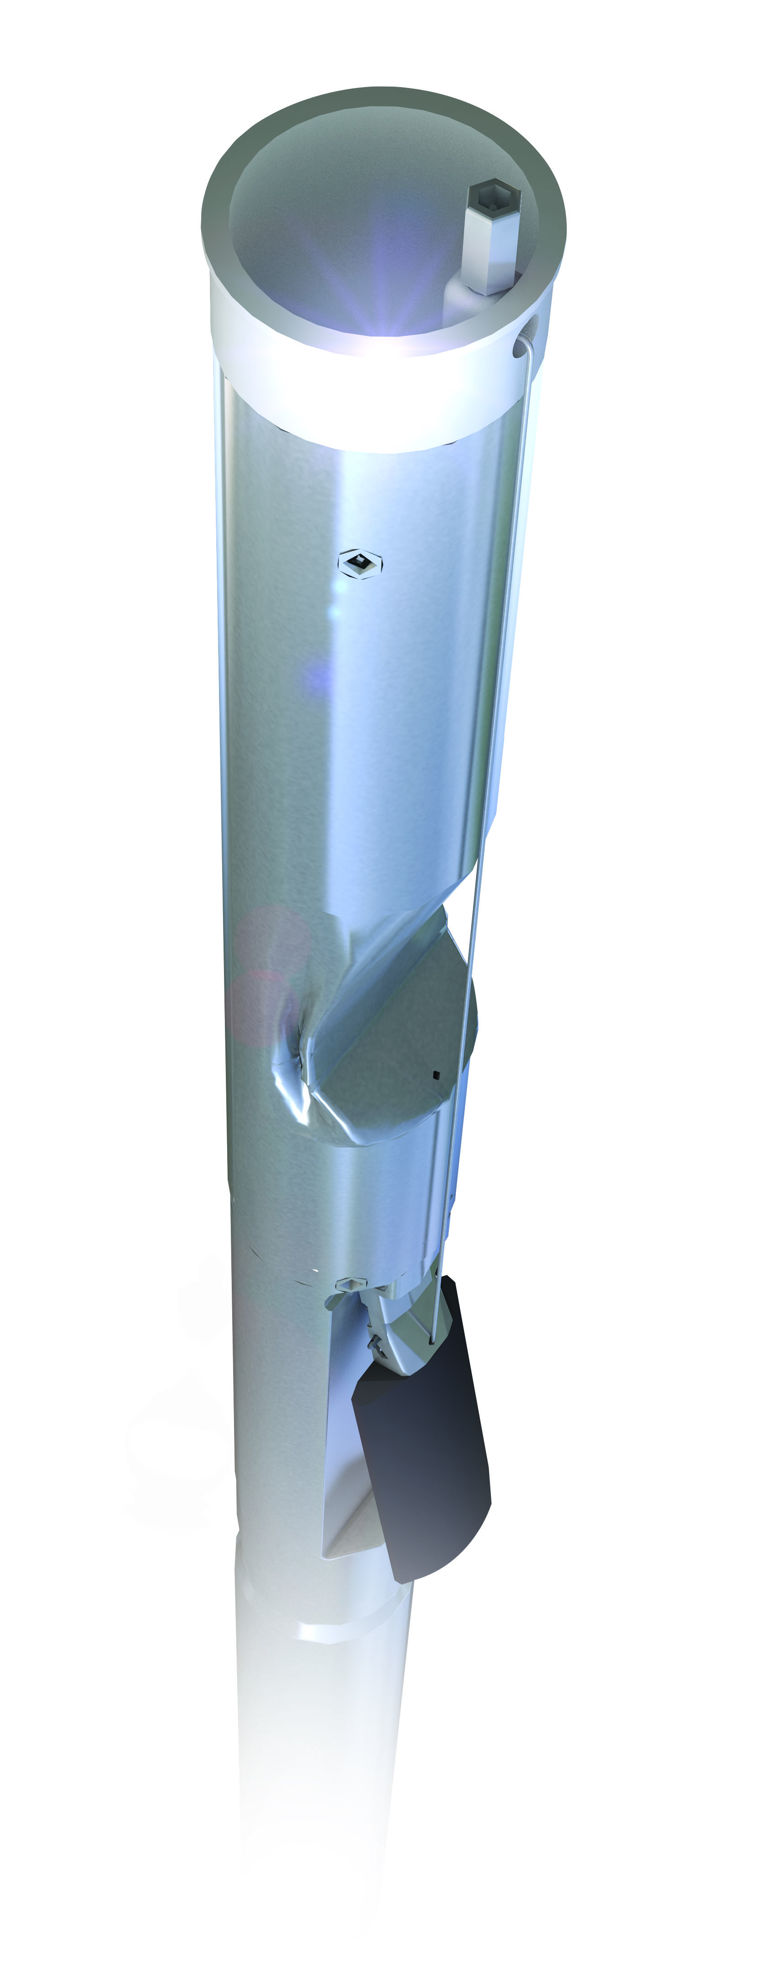
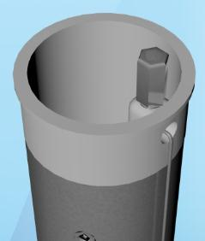
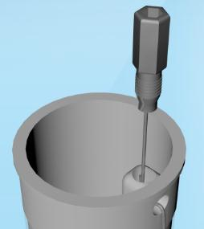
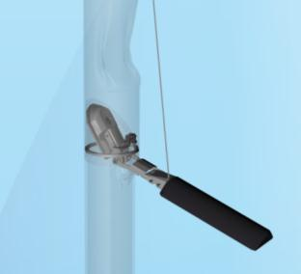
Overfill Prevention Solution
The easiest, quickest, and most cost efficient way to ensure that your overfill valves will operate when called upon….verifiable without removing them from the tanks.
Test in 60 seconds vs. 60 minutes per tank!
Lift Float with
Cable to Simulate Fill
Validate Proper
Poppet Operation
Loosen Test Plug

Slide 20


Slide 21
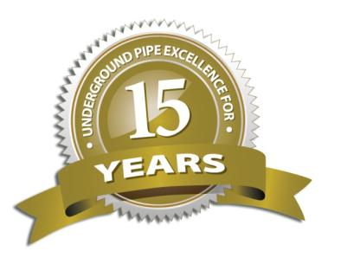

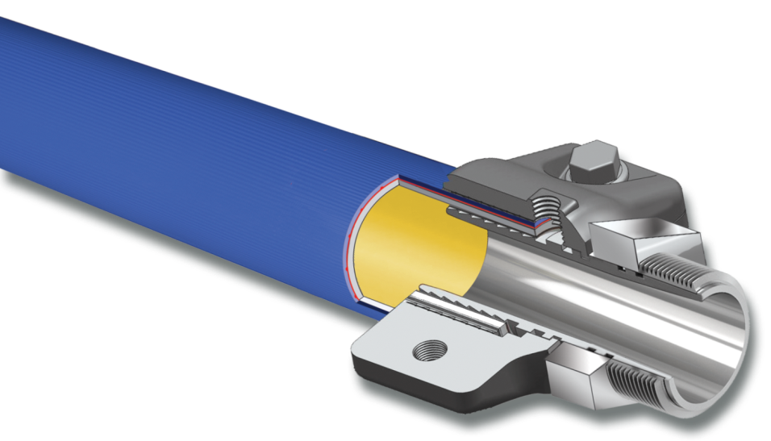
The Gold Standard in Fuel Piping
15 years of stellar performance using the best materials in the world
KYNAR (PVDF) - the foundation of our pipe’s time proven performance
    has a 50 year track record of use in the world’s most demanding chemical handling applications
All Fuels
Bonded Construction
New Profile
Added Flexibility

Slide 22

UL Fuels Listing
The New Pipe has the additional Concentrated Fuels Listing as shown below:
Motor Vehicle Fuels
100% ASTM Reference Fuel No. 2
100% ASTM Reference Fuel C
85% Reference Fuel C - 15% MTBE
85% Reference Fuel C - 15% Methanol
70% Reference Fuel C - 30% Ethanol
High Blend Fuels
50% Reference Fuel C - 50% Methanol
50% Reference Fuel C - 50% Ethanol
Concentrated Fuels
100% Methanol
100% Ethanol
100% Toluene
Aviation and Marine
100% Premium Leaded Gas
100% Kerosene

Slide 23
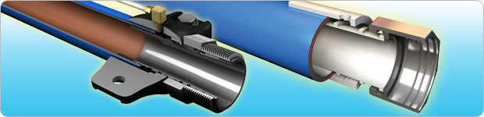
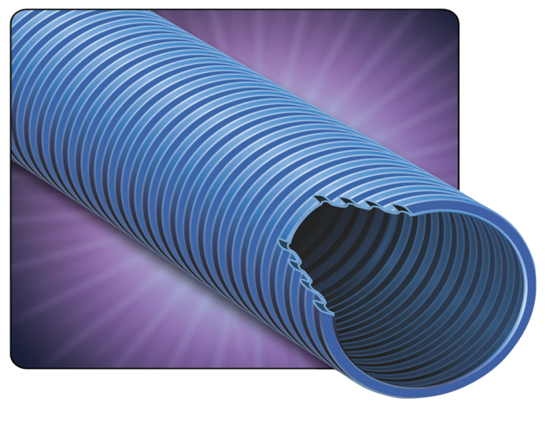
FlexWorks Piping System
UL / ULC Listed Pipework
Available in:
¾”
1”
1½”
2”
3” DW

Slide 24
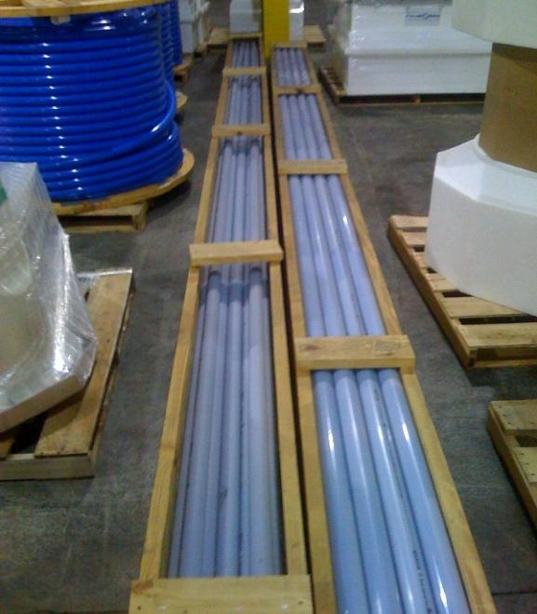
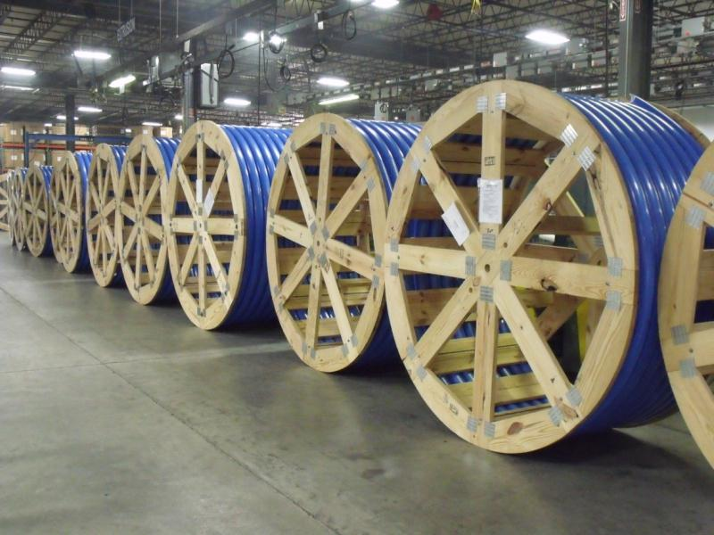
FlexWorks Pipe Options
Reels of 500 ft -1000 ft standard
Boxes standard at 250 ft
Stick Pipe in 25’ and 33’ increments

Slide 25
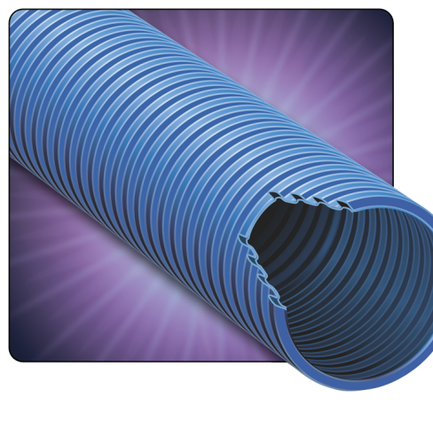
FlexWorks Dual Wall Access Pipe
4”diameter corrugated flexible conduit permits the future replacement of Flex piping
High density polyethylene (not intended for use as a secondary containment pipe)
Strong enough to withstand H-20 loading requirements when properly buried
Thick enough to minimize damage from shipping and jobsite handling
Can accommodate ¾”, 1”, 1 ½”, 2” and 3” Flex supply pipe
Additional Features and Benefits
Crush and puncture-resistant
Saves time and money
Improves leak detection capabilities
Improves leak detection capabilities
Delivered in continuous lengths
Allows access to piping system from above ground

Slide 26
Pipe Couplings
Double Wall Swage-on Couplings
Double Wall Bolt-on Couplings

Slide 27
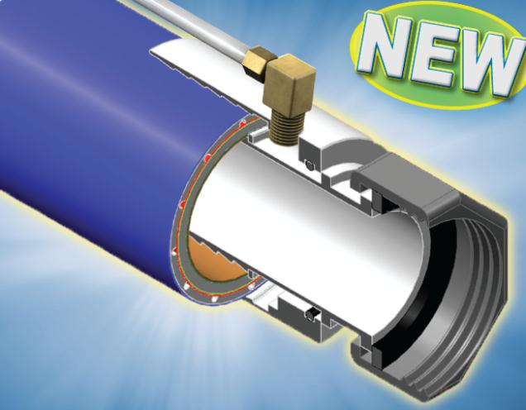
Double Wall Swivel Coupling
NEXT-GENERATION SOLUTIONS FOR
NEXT-GENERATION REQUIREMENTS
This unique coupling offers the following benefits:
Double Wall Swivel Pipe Couplings provide for an interconnected interstitial system that may be continuously monitored or periodically tested
No temporary test boots
No trimming back of the secondary pipe jacket

Slide 28
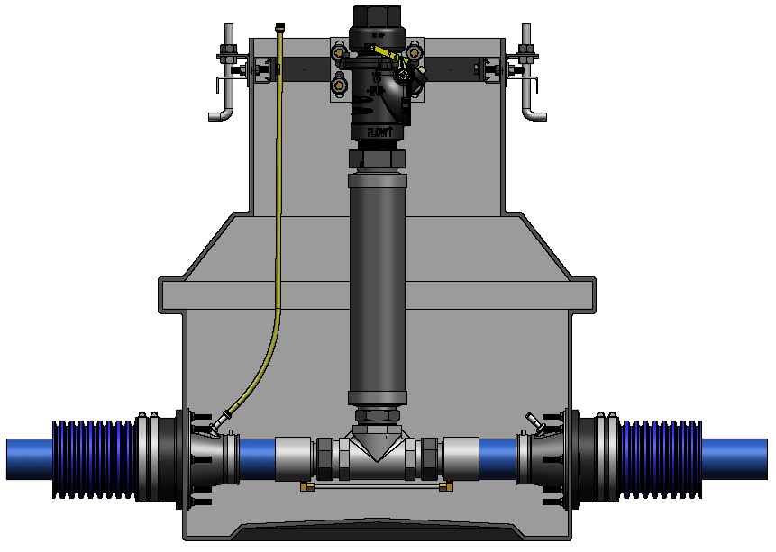
DPC – Double Wall Pipe Couplings
Air Valve Test Jumper
Stabilizer Bar
Shear Valve
Dispenser Sump
Braided SS Flex Connector
Tee Fitting
Access Pipe
DPC Jumper Tube
Double Entry Boot with Test Port
FlexWorks DW Pipe
DW Coupling

Slide 29
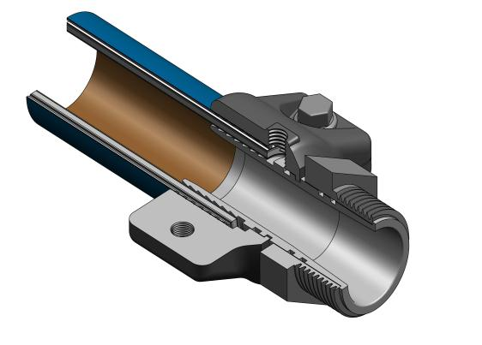
Swivel Bolt-On Coupling
A new generation double wall swivel barbed fitting that allows customers to receive the same great features as a swage on double wall fitting, but without the use of a coupling machine.
This unique coupling offers the following benefits:
Currently available in 1½” and 2”
NPT male thread allows fitting to be used with standard plumbing fittings
Quick and easy to install
No jacket stripping
No test boots
Provides quick and effective means to re-test secondary containment
Compatible with E85 applications
Permanent Interstitial Access Ports
Secondary
Flow
Primary Flow
Threaded Clam Shell
Connection
Male NPT Threads

Slide 30
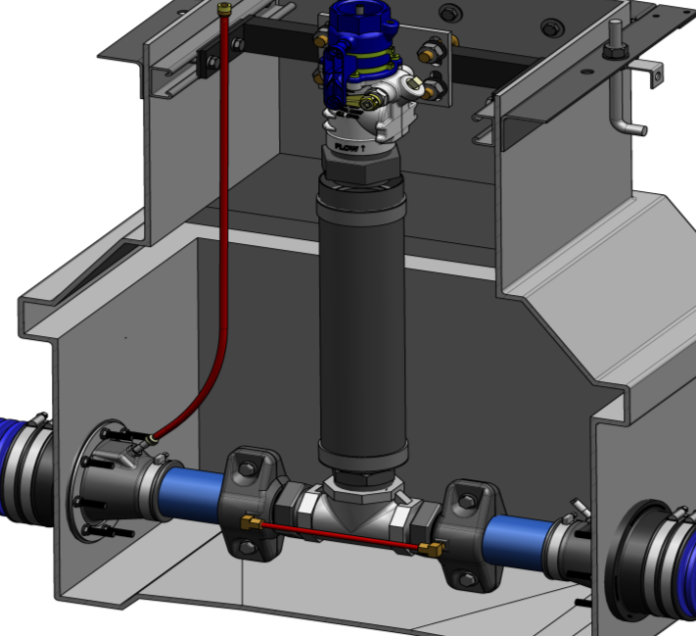
Swivel Bolt-On Coupling Profile
Air Valve Test Jumper
Stabilizer Bar
Shear Valve
NPT Tee Fitting
Access Pipe
Male Swivel Bolt-On Coupling
Jumper
Tube
Double Entry Boot
Access Pipe

Slide 31
Australia
Entry Fittings
Single Sided Flexible Entry Fittings
Double Sided Flexible Entry Fittings
Rigid Entry Fittings

Slide 32
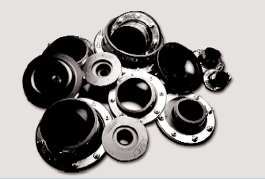
Australia
EBF / Single Entry Fittings
Single Flexible Entry Boots Features and Benefits
  Watertight pipe and conduit entries
  Installation on flat or round surface
  Permits angled entries up to 15 degrees
  Low cost with proven reliability
  No exposed metal parts to the underground environment
  Accommodate rigid and flex pipe, ducting and conduit
  UL Listed
.

Slide 33
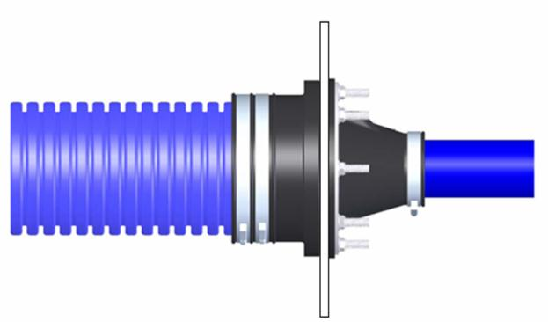
DEB – Double Entry Fittings
Double Flexible Entry Boots
Designed to seal the sump penetration
Incorporate both internal and external band clamps to provide additional sealing
Firmly fasten and seal to the sump wall using steel studs, fasteners and a galvanized compression ring
Available in a variety of sizes and designs to accommodate rigid and flexible piping, ducting and conduit
Features and Benefits
  Watertight pipe and conduit entries
  Installation on flat or round surface
  Angled entries up to 15 degrees
  Provides clean dry environment
  Accommodates various site installations
  Allows for easy field adjustments
  Can be repaired if damaged

Slide 34
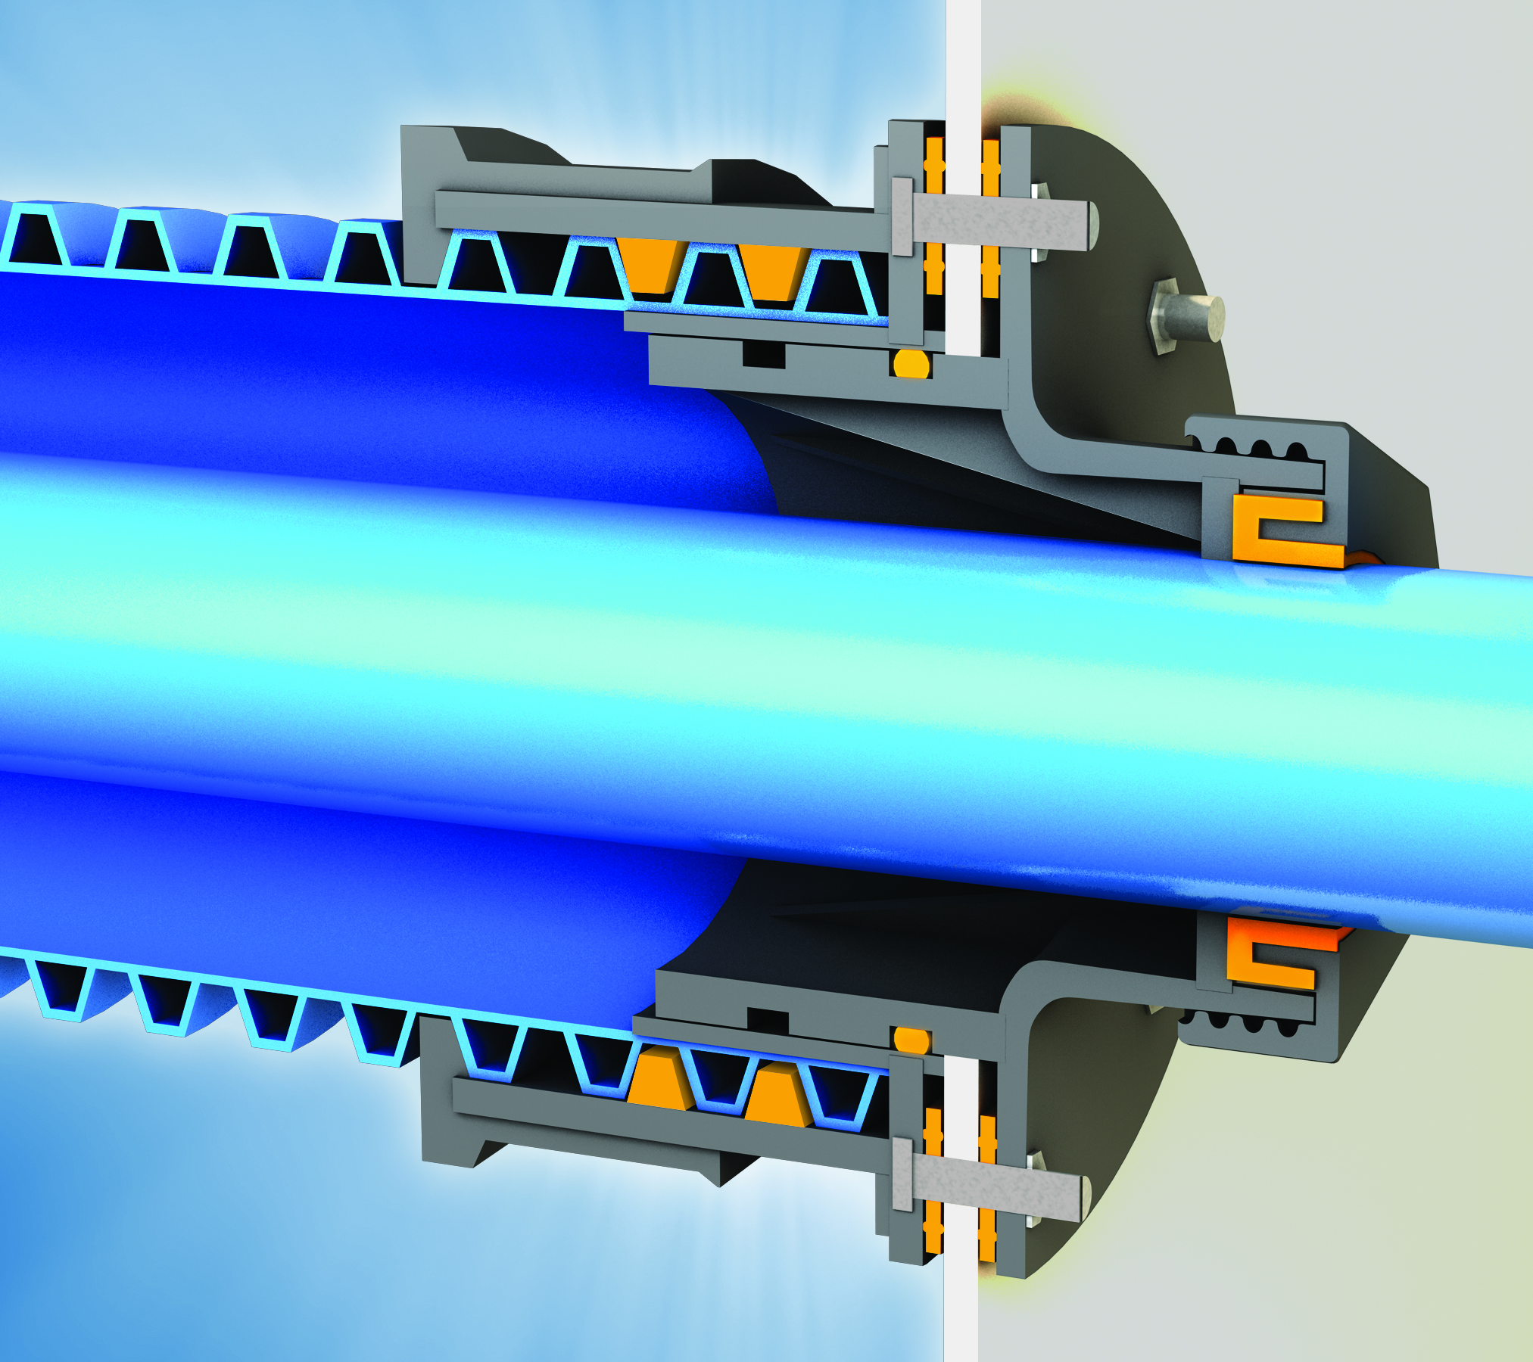
The “REF” Rigid Entry Fitting
NEXT-GENERATION SOLUTIONS FOR
NEXT-GENERATION REQUIREMENTS
Introducing...A Rigid Entry Fitting...with minimal exposed rubber...that still accommodates ground movement.
Sealing redundancy throughout – Maximum containment and unmatched protection from water intrusion
Preserves total accessibility – for monitoring, maintenance, testing, and repair
Maintains flexibility to accommodate pipe and ground movement
Hard shell exterior – To weather the elements and abuse of the underground environment
33

Slide 35
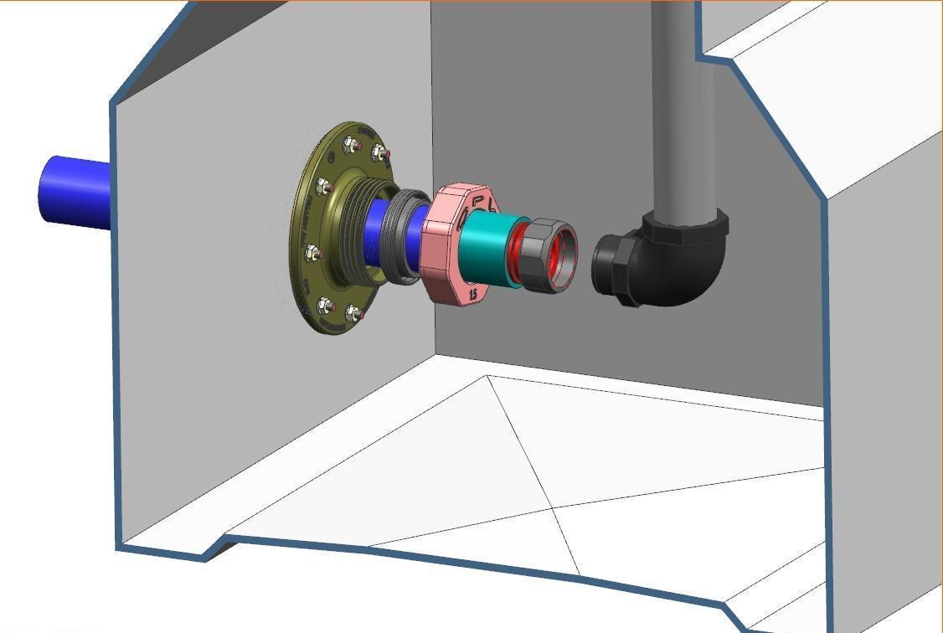
The “REF” Rigid Entry Fitting

Slide 36
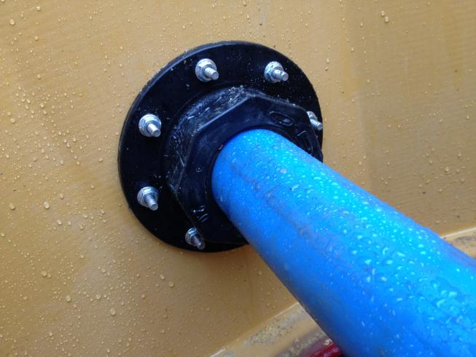
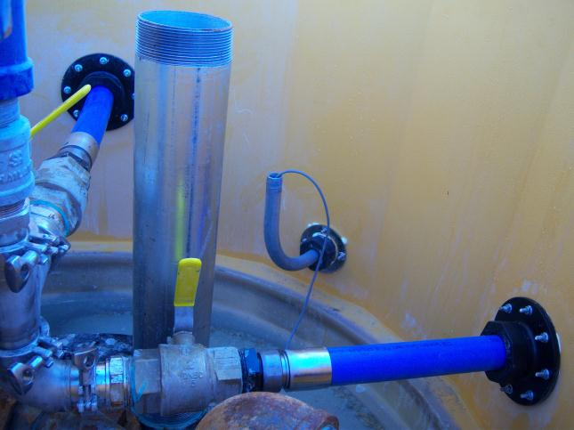
REF – Rigid Entry Fitting

Slide 37
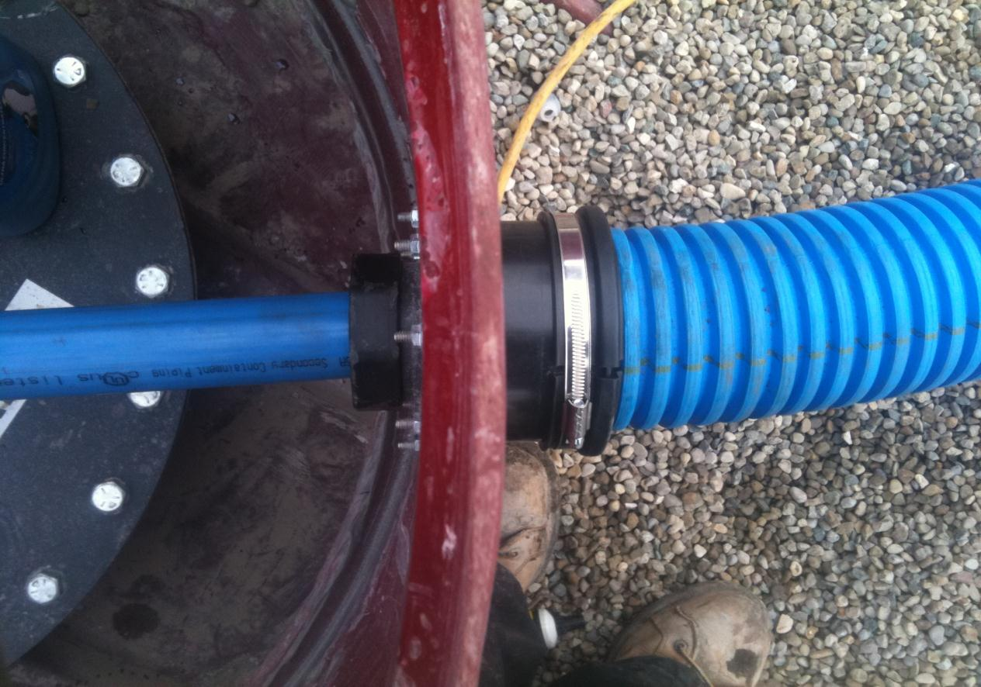

Slide 38
Tank Sumps
Polyethylene – Mechanical Lid
Two Piece Fiberglass – Mechanical Lid
Filament Wound – Mechanical Lid

Slide 39
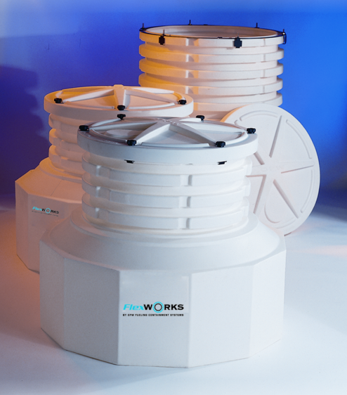
TSM / Polyethylene – Mechanically Fastened Lid
Features and Benefits:
  Long-Term Watertight Performance/Strength & Rigidity - one piece design provides reliable watertight integrity and long product life. Designed to resist deformation under burial and high water table forces.
  Installation Flexibility - multiple flats provide maximum area for locating pipe entries.
  Easy Field Height Adjustability - the special ribbed height adjustment design makes adjustments to finished grade, if necessary, quick and easy.

Slide 40
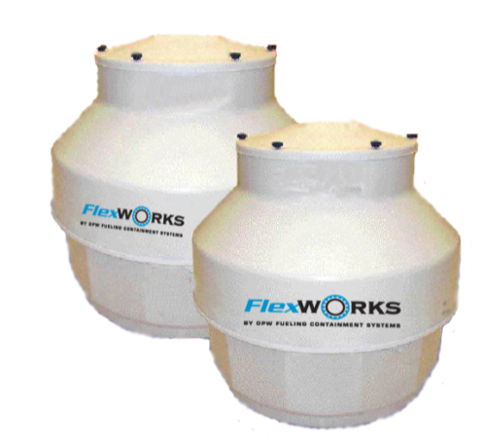
TSMF / Two Piece Fiberglass Sumps and Resin Kits
Features and Benefits
  Structural Integrity - engineered with thick walls and a structurally efficient geometry to withstand backfill and high water table forces. Precise glass/resin metering throughout the molding process ensures material consistency and maximizes the strength-to-weight ratio.
  Smooth/Flat Sealing Surfaces for Leak - Tight Sump Entry Fittings - male/female injected molded halves produce a uniform wall thickness while eliminating air entrapment. The result is a flat, smooth finish, both inside and out, which provides leak-tight pipe entries
  Full Access Working Area - two-piece design allows full access until top is attached after plumbing is complete
  Flexibility in Mounting - sump can be mounted directly to a 42" FRP containment collar or with OPW FCS Sump Mounting Flanges.

Slide 41
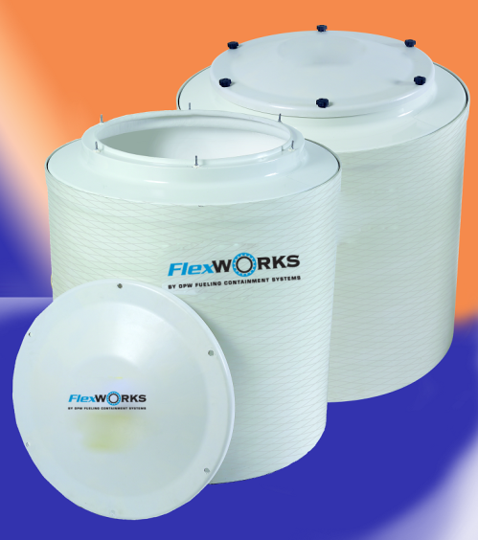
Australia
TRFS / Filament Wound Tank Sumps
Features and Benefits:
Filament Wound - offers a consistent wall thickness that provides superior structural integrity and impact resistance.
Smooth Sealing Surface - uniform wall thickness and smooth finish, both inside and out, provide for reliable sealing areas for leak-tight pipe entries
Full Access Working Area - two-piece design allows full access to sump interior for installation of entry fittings and piping. Once installation of all piping is complete, the top is attached to the base.
Homogeneous Vinyl Esther Resin Throughout - provides an excellent permeation barrier and is compatible with all current fuel mixtures; superior to Isothalic resin.

Slide 42
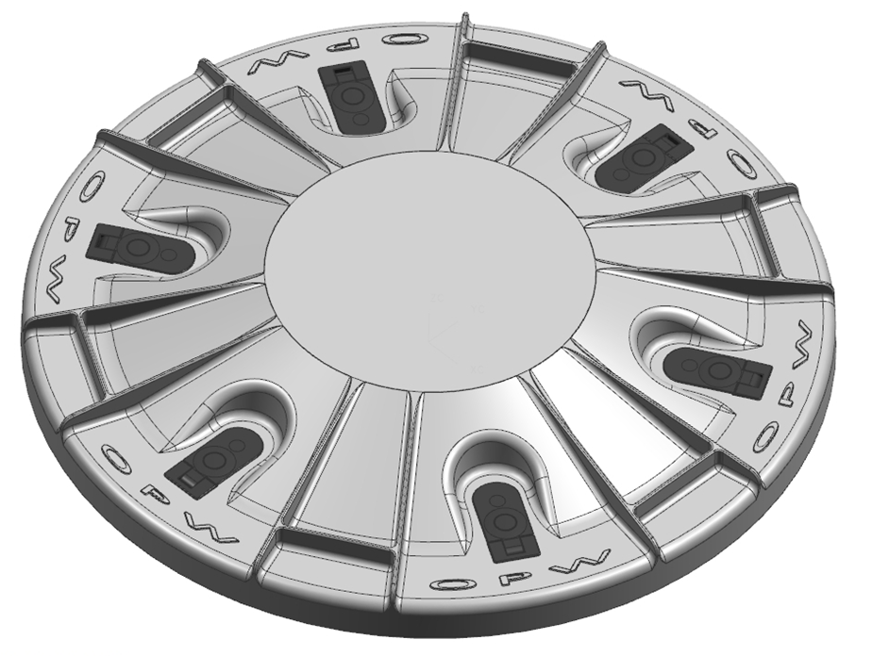
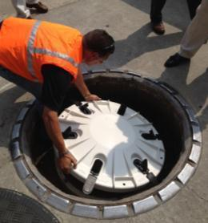
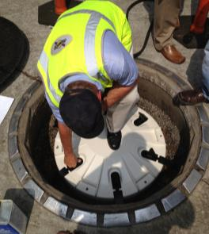
Fiberglass Latched Tank Sump Lid
Six latch and cover design to ensure even sealing
Holes in the lid to allow installation on 33” Fiberglass or Polyethylene Tank Sumps
Lid strength is three times stronger than our previous lid
Retrofitable to existing OPW Polyethylene and Fiberglass Tank Sumps that have the mechanically fastened lid.
Tank Sumps available with the new lid:
  TSMF-4536CL
  TSDF-4536CL
  TRFS-4260CL

Slide 43
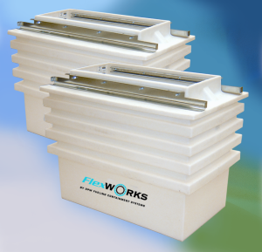
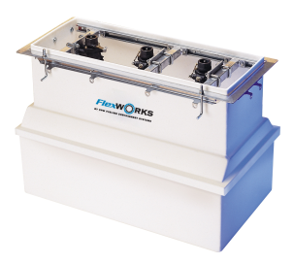
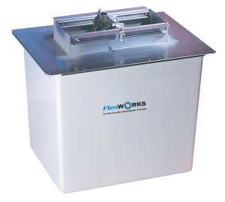
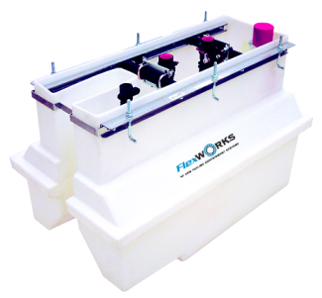
Dispenser Sumps
One Piece Polyethylene
Wide Access Polyethylene
Wide Access Fiberglass
One Piece FRP

Slide 44

Australia
DS / One Piece Polyethylene
Features and Benefits:
Structural Reinforcing on Large MPD Models - Prevents sump deformation from backfill and high water table forces.
Light Color - Preserves rigidity in sunlight before backfill and provides maximum visibility after installation.
Full Perimeter Liquid Collection Channel - Facilitates quick leak detection and allows flexibility in locating leak sensors.
Integral Rain Lip - Protrudes into the dispenser frame to prevent surface water entry.
Easy Installation - Field height adjustment capability and large pipe entry area ensures installation flexibility
All dispenser models are now conduitless

Slide 45

DSW / Wide Access Polyethylene
Contractor-friendly, open-top containment chamber for unrestricted access to the piping connections during installation
Features and Benefits:
  Contractor-Friendly Installation – Open top provides unrestricted access to the inside of the containment chamber to facilitate entry fitting and piping installation. Dispenser mounting frame is attached after plumbing is complete.
  Deeper Burial Capability – 37" burial depth allows piping slope requirements to be met more easily in layouts with long piping runs.
  Simple Field Height Adjustment – The top portion of the chamber can be quickly and easily trimmed along the ribs to ensure maximum installation flexibility.
  Structural Integrity – Engineered with heavily ribbed walls to withstand backfill and high water table forces.

Slide 46

DSF / Fiberglass Dispenser Sumps
Monolithic construction
1" rain lip
Easy installation of fittings
Smooth sealing surfaces
Various models allow for height adjustability

Slide 47

The Loop System

Slide 48

The Loop System
What?.....The Loop System
A revolutionary underground piping system that eliminates more than 50% of field fabrication and the associated problems.
This unique fuel delivery system minimizes:
Complexity of Piping Installation
Site Assembly Labor and Associated Mistakes
Piping Connections (Leak Points)

Slide 49

The Loop System
Why?.....The Loop System
To Attain a Higher Level of Environmental Protection
Complexity of Piping Installation
Enhance Long Term System Reliability
Enhance the ability of owners to inspect, maintain, monitor, and identify and easily repair any potential problem that may develop BEFORE there is an environmental or safety issue.

Slide 50
The Loop System
How?.....The Loop System
Drastic reduction in complicated field plumbing and assembly operations and the associated opportunities for installation errors:
Pre-Assembled Dispenser sumps with factory installed pipe entry boots, stabilizer bars, and OPW 10 Plus shear valves with enhanced low impact protection.
Elimination of temporary test boots
Elimination of the need to measure, cut, thread, and install steel or flexible riser pipes (more joints eliminated)
Elimination of the need to ever remove the dispenser to inspect, repair, or replace pipe sections
Elimination of the need to trim back the secondary pipe jacket before coupling pipe

Slide 51


The Loop System
Quick Connect Dispenser Sumps
Junction Dispenser Sumps
Terminating Dispenser Sumps

Slide 52
The Loop System
What’s in it for Me?
Site Owner
  Less Contractor Dependent Installation + Top of The Line Components = Better Site Integrity and Performance
  Total Accessibility to all Underground Equipment without Excavation = Lower Cost of Ownership
Contractor
  Reduced Installation Complexity (Plug & Play) + Quick, Bulletproof Site Installation/Testing = Less Opportunity for Errors/Call Backs and a Profitable Job
Regulator
  Better Installation + Better Components + Better Maintenance and Monitoring Capability = No Gas in the Ground

Slide 53








Who Has Specified Loop?

Slide 54
Thank You!

