Slide 1
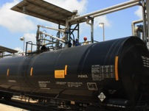
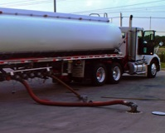

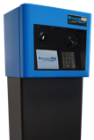
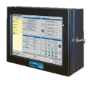
Leading The Way In
Fluid Handling Solutions Worldwide
Chemical & Industrial
Transportation
Retail Fueling
Electronic Systems

Slide 2
OPW GLOBAL
Founded in 1892
Fluid handling specialists
1,650+ employees worldwide
Offices in United States, Brazil, China,
The Netherlands, Poland, Canada, Philippines, India, Mexico, Czech Republic, Sweden and UK
ISO 9001-certified since 1993
Part of Dover Corporation since 1961

Slide 3

WHAT IS DOVER CORPORATON
Multi-billion dollar diversified manufacturer of
industrial / commercial products (nyse:dov)
Global enterprise with customers in more
than 100 countries
Organized into four market segments comprised
of more than 39 independent business units

Slide 4


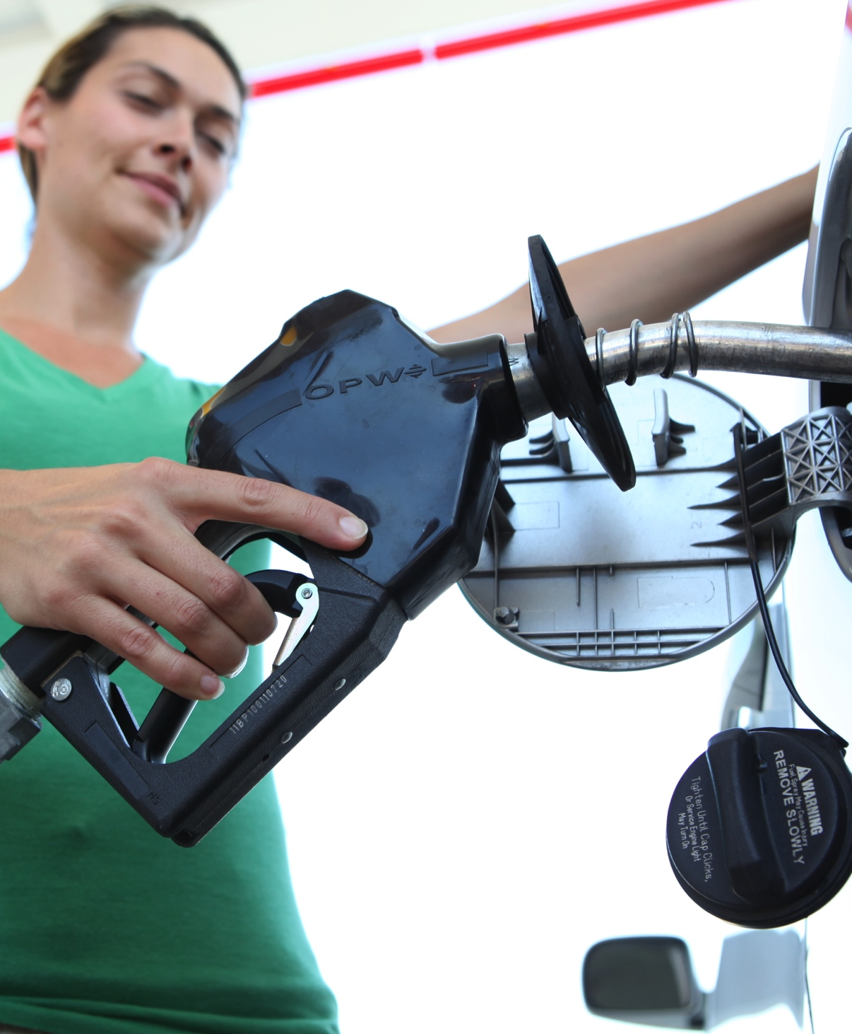
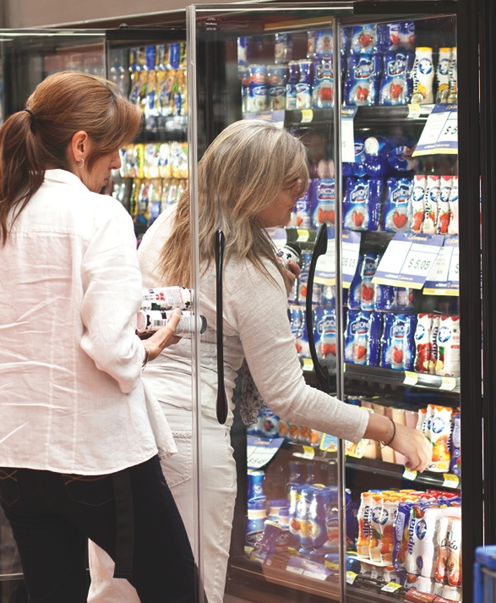

WHAT IS DOVER CORPORATON
Energy
Engineered
Systems
Fluids
Refrigeration & Food Equipment

Slide 5

OPW GLOBAL OPERATIONS
Calgary, CA
De Pere, WI
Kungsör, Sweden
Chicago, IL
Quebec, CA
•
Kansas City, MO
Cincinnati, OH
Skipton, UK
•
Moscow Russia
Beijing, China
Lianyungang, China
Shanghai, China
Suzhou, China
Guangzhou, China
Manila, Philippines
Amsterdam, NL
Prague, CZ
Kraków, Poland
Smithfield, NC
•
•
Istanbul, Turkey
•
Ibéria, Spain
Houston, TX
•
•
Mexico City, Mexico
New Delhi, India
Mumbai, India
Chennai, India
Bangalore, India
•
•
•
•
•
Kuala Lumpur, Malaysia
Singapore, Singapore
•
•
Melbourne,
Australia
Sidney,
Australia
•
Jundiaí - SP, Brazil
Manufacturing Facilities:
U.S., South America, Europe & Asia
•
•
Engineering Center
Sales Offices

Slide 6
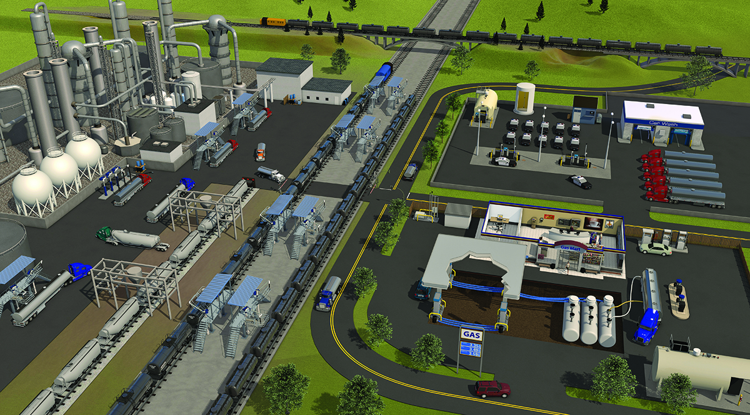
OPW GROUP
Chemical & Industrial
Transportation
Retail Fueling
Electronic Systems
Focused on customer-driven solutions for the safe and efficient handling and distribution of fuels and critical fluids
from production to consumption worldwide

Slide 7
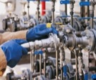
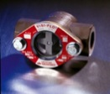
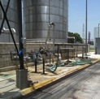
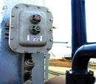
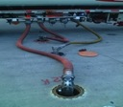
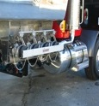
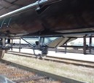
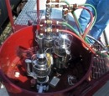







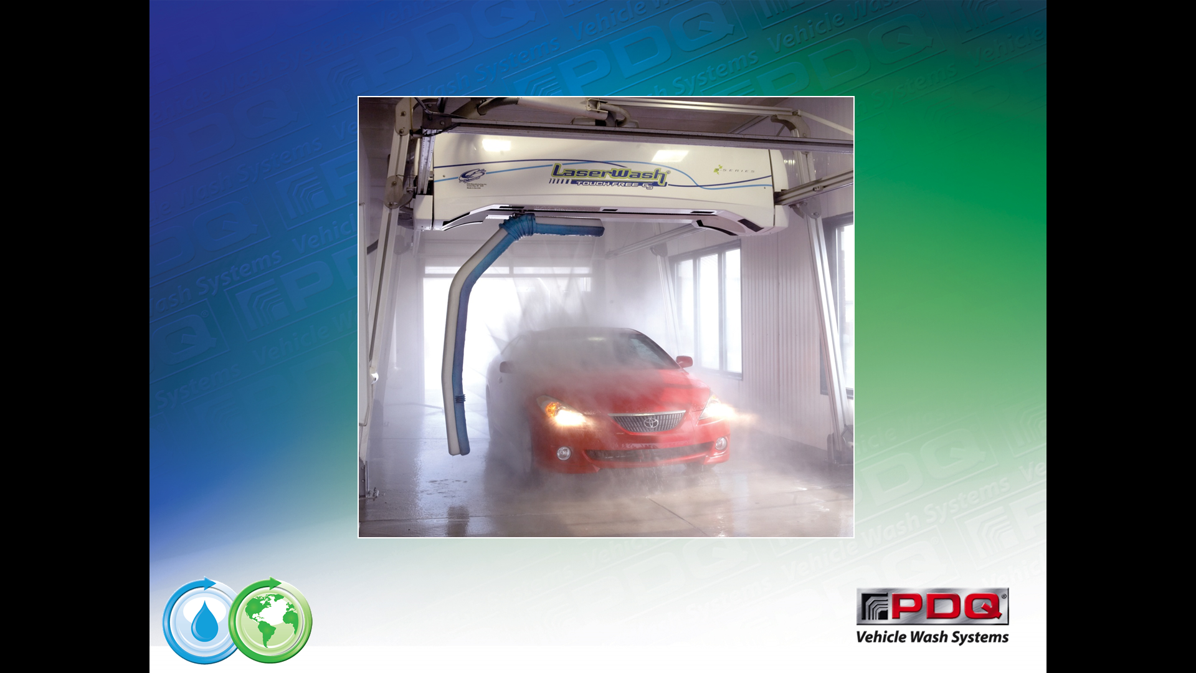




FOUR BUSINESS UNITS
CHEMICAL & INDUSTRIAL
Safe and efficient loading and unloading of critical hazardous chemicals: loading arms, swivel joints, sight flow indicators, quick and dry disconnect couplers, and safety breakaways
TRANSPORTATION
Components and systems for use on rail tank cars to ensure the safe handling, loading, transport and unloading of hazardous bulk products. Products for petroleum, chemical and dry bulk cargo tanks
Dry Disconnects
Sight Flow Indicators
Loading Arms
Rack Monitors
Unloading Equipment
Cargo Tank Equipment
Rail Car Equipment
Rail Car Valves
RETAIL FUELING
Components and products to protect the environment and the consumer at retail fueling sites for conventional and alternative fuels
ELECTRONIC SYSTEMS
Electronic tank gauges and fuel control systems to monitor and control fuel inventories. Innovative automatic vehicle wash systems
Nozzles & Accessories
Piping & Containment
Underground Storage Equipment
Fuel Control Systems
Tank Gauges
Vehicle Wash Systems

Slide 8
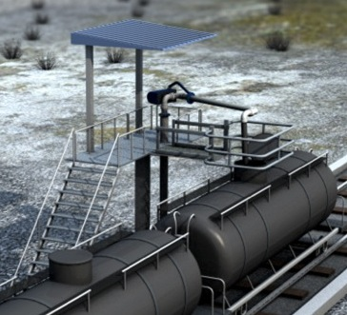
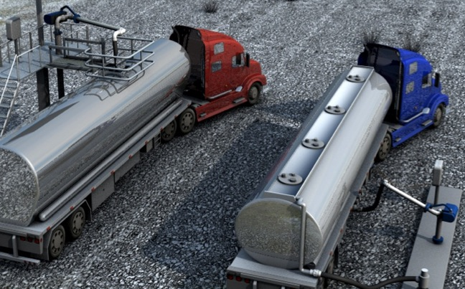

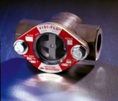
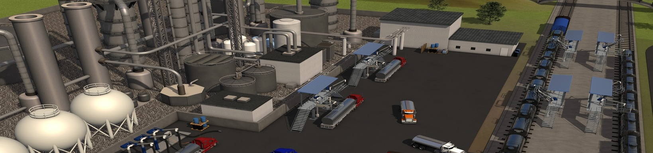


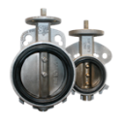
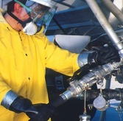
CHEMICAL & INDUSTRIAL
Chemical & Industrial
Top & Bottom Loading Systems & Accessories
Ground Verification / Rack Monitoring Equipment
Bottom Loading / Unloading Couplings
Quick & Dry Disconnect Couplings
Industrial & Butterfly Valves
Sight Flow Indicators
Swivels

Slide 9
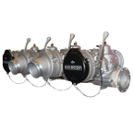
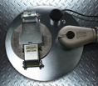
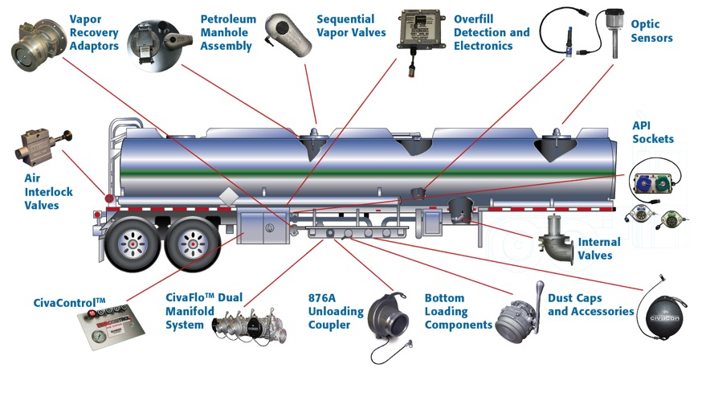
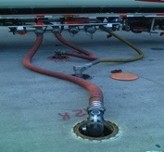
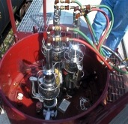


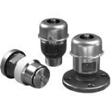
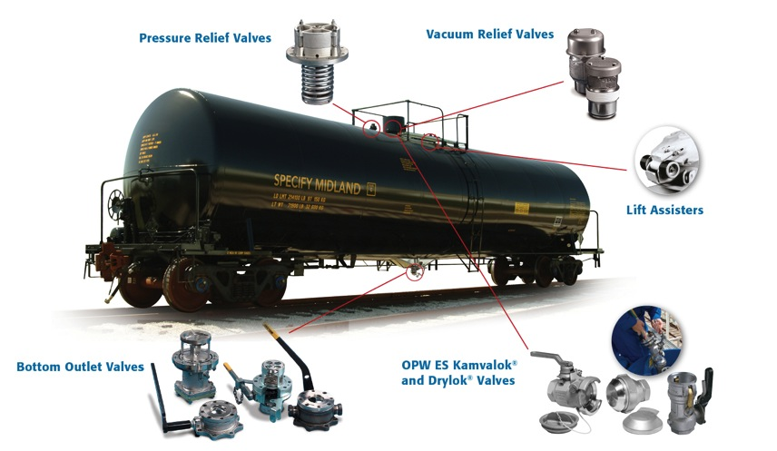

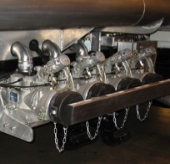
TRANSPORTATION
Petroleum Tanker Truck Equipment
Petroleum Straight Truck Equipment
Dry Bulk Tank Truck Equipment
Dry Bulk Rail Tank Car Equipment
Pressure Rail Tank Car Equipment
General Purpose Rail Tank Car Equipment

Slide 10
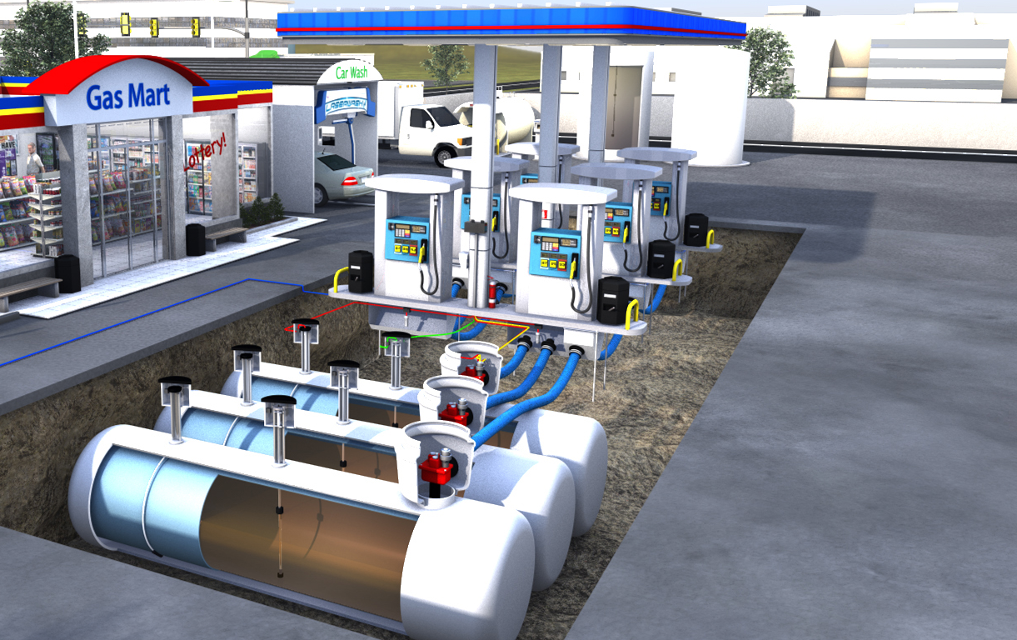
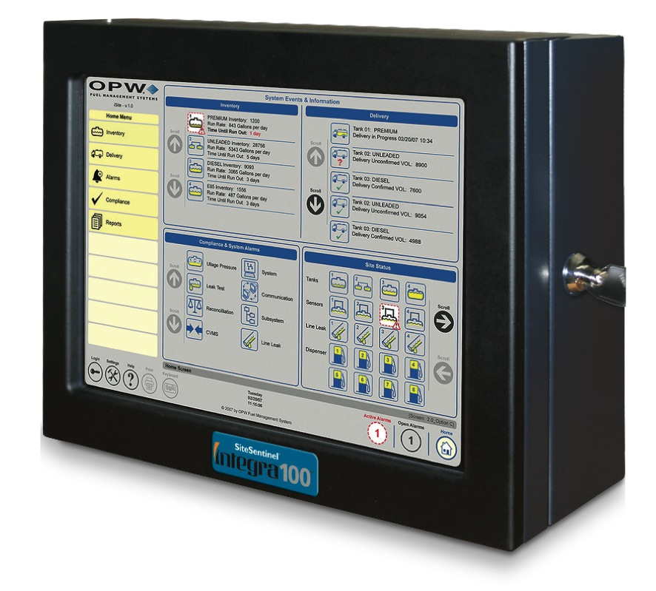
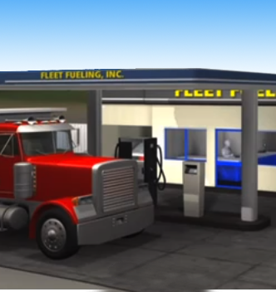




ELECTRONIC SYSTEMS
Retail Fueling:
Tank Gauges
IntelliSense™ Sensors
Model 924B Magnetostrictive Probes
Model 327 Volumetric Line Leak Detector (VLLD)
Fleet Fueling:
Fuel Controls (FIT500, C/OPT, K800™ Hybrid, PV100™, PetroLink™,
Dispenser Terminal Control (DTC)
Phoenix™ SQL and Phoenix Fuel Management Software
Automatic Vehicle Wash Systems:
LaserWash® 360 (Touch Free Washes)
LaserWash® AutoXpress
LaserWash® Touch Free GS Series
ProTouch® Tandem Light Touch Wash
ProTouch® Icon Light Touch Wash

Slide 11
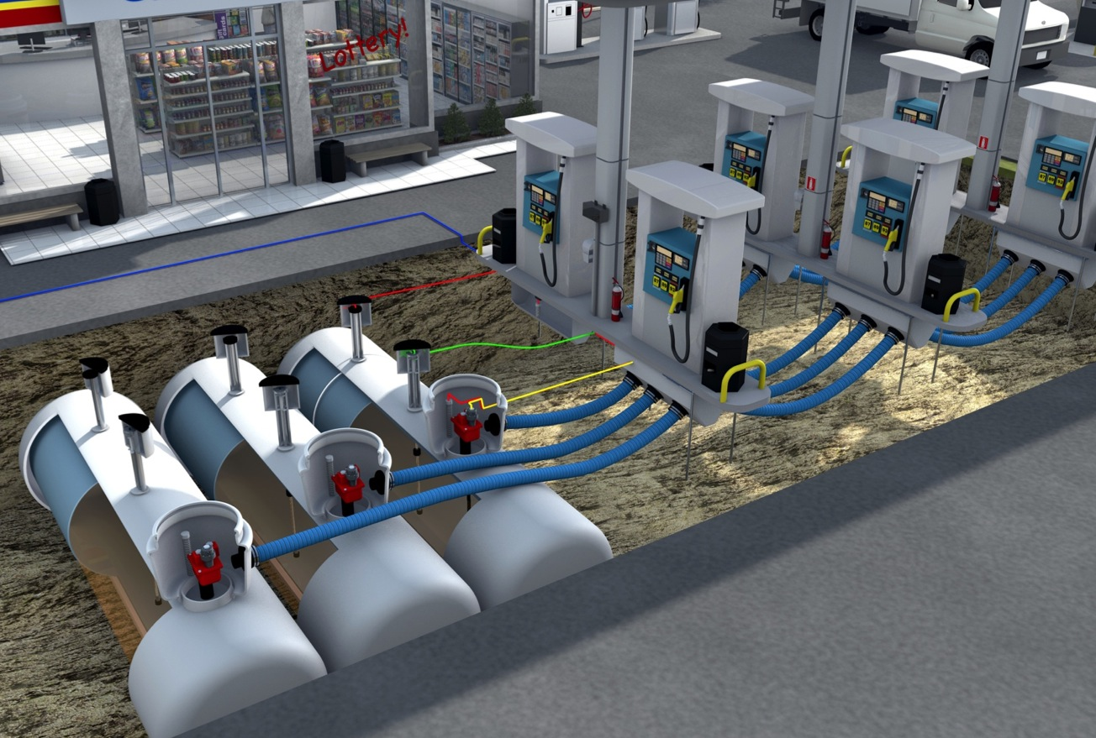
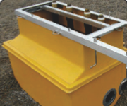
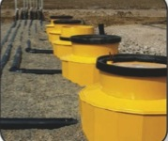


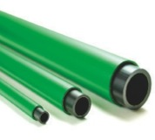
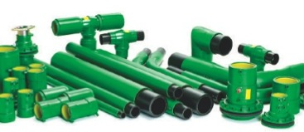
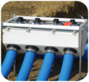



RETAIL FUELING
Above Ground Products
Dispensing Hardware
Above Ground Storage Tank Equipment
Stage II Vapor Recovery Equipment
CleanEnergy Fueling Products
(CNG, LPG, Hydrogen Nozzles and Accessories)
Below Ground Products:
OPW Piping & Containment Systems
OPW Underground Storage Tank Equipment
KPS Petrol Pipe System™ Products
Fibrelite Watertight Composite Manhole Covers, Modular Trench Panels and Underground Enclosures

Slide 12
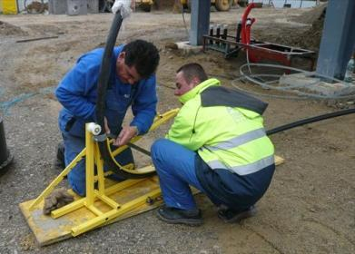
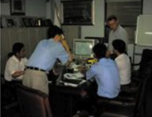
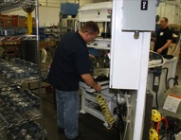
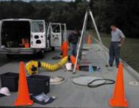
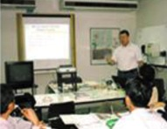
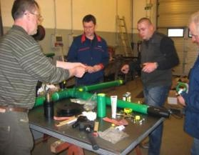
OPW GLOBAL TECHNICAL SUPPORT
Technical Seminars
On-Site First Installation Visits
Telephone / Internet Contact
Locations Worldwide:
  United States
  Brazil
  China
  Poland
  India
  Australia
  Malaysia
  Sweden
  UK
  Mexico
  Czech Republic

Slide 13
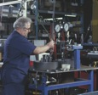
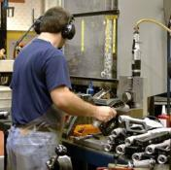
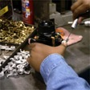
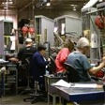
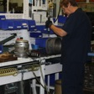




WORLD CLASS MANUFACTURING
Six Sigma
Lean Manufacturing/One-Piece Continuous Work Flow
Continuous Quality Improvement Process
ISO 9001 Certified
Fully Robotic Automation Nozzle Line
OPW-FMS Tank Gauge ISO-17025

Slide 14






TEST / PRODUCT DEVELOPMENT CAPABILITIES
Rapid Prototyping Stereolithography
Environmental Chambers
Experimental Machine Shop
Tank Gauge Testing Lab
Manhole Cover Stress Tester
Fluid Dynamics Modeling
Life-Cycle Test Stations

Slide 15







KEY U.S. MANUFACTURING FACILTIES
OPW FUELING COMPONENTS
Cincinnati, OH
OPW FUELING
CONTAINMENT SYSTEMS
Smithfield, NC
OPW FUEL
MANAGEMENT SYSTEMS
Chicago, IL
OPW ENGINEERED SYSTEMS
Lebanon, Ohio
OPW MIDLAND
Skokie, IL
OPW CIVACON
Kansas City, MO
OPW PDQ
De Pere, WI

Slide 16










KEY GLOBAL MANUFACTURING FACILITIES
OPW EMEA
Kungsör, Sweden
OPW EUROPE
The Netherlands
OPW LATIN AMERICA
Jundiaí - SP, Brazil
OPW FIBRELITE
Skipton, United Kingdom
and Kuala Lumpur
OPW CZECH REP.
Klasterec,
Czech Republic
OPW ASIA PACIFIC
Suzhou, China
OPW INDIA
Chennai, India
OPW LIQUIP
Sydney, Australia

Slide 17








OPW RETAIL FUELING – LEADING THE WAY IN FUELING INNOVATION WORLDWIDE
Piping & Containment Systems
  Innovative Loop System™
  Flexible, Double Wall Piping Systems
  Containment Sumps & Fittings
Underground Storage Equipment
  Spill Containers and Manholes
  Underground Storage Tank Components
  Fill Pipe Connection Equipment
  Overfill Prevention and Emergency Valves
Above Ground Storage Tank Equipment
Conventional & Vapor Recovery
Dispensing Equipment
Clean Energy Fueling Products

Slide 18




FIBRELITE – INDUSTRY LEADING PRODUCTS FOR ALL APPLICATIONS
Retail Petroleum Products
Covers
Tank & Dispenser Sumps
Pipe Kits
Underground Enclosures
Utilities & Industrial Products
Covers
Trench Covers
Pipe Kits
Underground Enclosures
Steam Covers
Covers
Gutters
Vault Panels
Accessories

Slide 19




KPS PETROL PIPE SYSTEM™ – MAKING FUEL FLOW SAFELY
KPS Petrol Pipe System™
Innovators leading the way
in technical development
Zero permeation piping
Electrostatically safe pipes
for explosive atmospheres
Knowledge and true
technical support
Approved to all major standards
KPS LPG Pipe System™
Non-corroding plastic LPG piping
Electrostatically safe
No permeation

Slide 20





OPW ENGINEERED SYSTEMS – FLUID HANDLING SOLUTIONS
Loading Systems
Top- and Bottom-Loading Arms
Electronic Rack Equipment
API Couplers
Safety Breakaways
Dry and Quick Disconnects
Quick Disconnect Fittings
Dry Disconnects
Swivel Joints
General Purpose Swivels
Hose Reel Swivels
Split Flange Swivels
Process Valves
Sight Flow Indicators
Chemical and Industrial Valves
Isolation Rings and Gauging Products
Pigging Solutions

Slide 21




CIVACON – TANK TRUCK PRODUCTS
Mechanical Tank Truck Products
Air Controls
API Adapters
Drop Elbows
Emergency Valves/Couplers
Manholes
Vapor Recovery Valves
Manifolds
Butterfly Valves
Electrical Tank Truck Products
Rack Monitors/On Board Monitors
Sockets and Cabling
Probes
Overfill Systems

Slide 22





MIDLAND – RAIL TANK CAR PRODUCTS
General Purpose Railcar Products
Gauges
Pressure Relief Valves
Vacuum Relief Valves
Rupture Disc Devices
Bottom Outlet Valves
Pressure Railcar Products
Top Transfer Valves
Gauges
Check Valves
Pressure Relief Valves
Pressure Differential Railcar Products
Pressure Manhole Covers
Check Valves
Pressure Relief Valves
Weld Rings

Slide 23










ELECTRONIC SYSTEMS – FUEL MANAGEMENT PRODUCTS
Fuel Control Systems
Petro Vend 100®, FIT500™, C/OPT™
Phoenix™ Fuel Management Software
Tank Gauges
SiteSentinel® Integra 100™
SiteSentinel® iTouch™
Probes & Sensors
IntelliSense™ Sensors
Magnetostrictive Probes

Slide 24





ELECTRONIC SYSTEMS – VEHICLE WASH SYSTEMS
Touchless Car Wash Equipment
  LaserWash® 360
  LaserWash® AutoXpress
  LaserWash® G5 S Series
  Friction Car Wash Equipment
  ProTouch® ICON
  ProTouch® Tandem
Pay Stations
  Access® Entry Stations
Options & Equipment
  LaserH2O® Reverse Osmosis (RO) Systems
  MaxAir Stand-Alone Dryer

Slide 25





LIQUIP – FLUID HANDLING SOLUTIONS
Liquip is a leading provider of innovative fluid handling solutions, such as market leading API bottom loading couplers, loading arms, tank truck valves and fittings, electronic measurement systems for tank trucks, fuel filtration systems and aviation fueling components and services.
  Truck Tanker Equipment
  Transport
  Pump and Metering
  Monitoring
Terminal and Depot Equipment
  Loading
  Storage
  Overfill Protection
  Aviation Fueling Components and Services
  Fuel Filtration

Slide 26















SUSTAINABILITY
Environmental Sustainability is a Cornerstone
of OPW’s Purpose & Product Offering –
Protecting People and the Environment
Fluid Handling Systems That Promote:
  • Clean Air • Clean Water • Safe Consumer Environments
Overfill Prevention
& Vapor Recovery
Overfill Prevention
& Monitoring
Vapor Recovery
& Emergency Valves
Safe Handling
& Spill Prevention
Rail Tank Monitoring
Vapor Recovery
Products
Spill
Prevention
Overfill
Protection
Fuel Transfer
& Containment
Tank
Monitoring
CleanEnergy
Fueling Products

Slide 27









OPW GLOBAL VISION
Consistently Deliver The Most Innovative
Fluid Handling Solutions To The World
THANK YOU
www.opwglobal.com

