Slide 1

OPW EVR PHASE 1 TRAINING Course
This class will cover how OPW equipment gets installed according to the manufactures installation instructions.
Notes:
This course I designed to inform the contractor and end user about how our products get installed and how different configurations could benefit the application. The most important feature of this course is the opportunity for the costumers to give feed back in order for OPW to improve or address issues pertaining to our products.

Slide 2
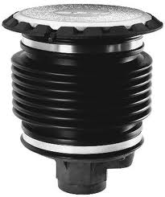
1-2100 SERIES DIRECT BURRY SPILL CONTAINERS
Configurations
5 or 15 gallon
Cast iron or composite base
Rain tight cover or sealable cover
Drain valve or drain plug
Notes:
Fill containers can have either a drain valve or a plug but vapor containers can not have a drain valve.

Slide 3
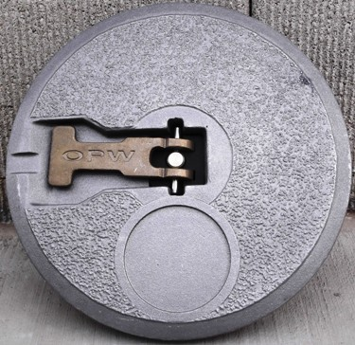
1-2100 SERIES DIRECT BURRY SPILL CONTAINERS
Sealable Cover!
Notes:
Sealable cover is offered as an option and can not be swapped out for a rain tight cover without changing the mounting ring. The mounting ring must not be changed in the field on a direct burry spill container, however a multi-port could be converted by swapping out mounting ring.

Slide 4
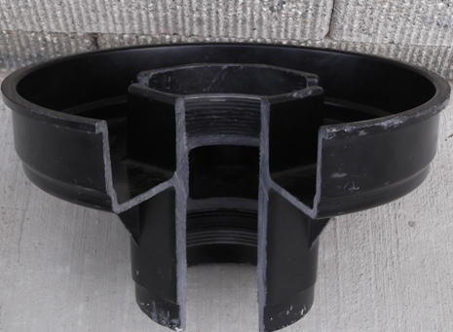
1-2100 SERIES DIRECT BURRY SPILL CONTAINERS
Composite Base!
Notes:
Composite base spill containers have a larger throat near the base to compensate for the material strength. An FSA-400 (tall) face seal adapter can only be used on composite base containers. An JSK 4410 (tall) jack screw assembly can only be used on composite containers.

Slide 5
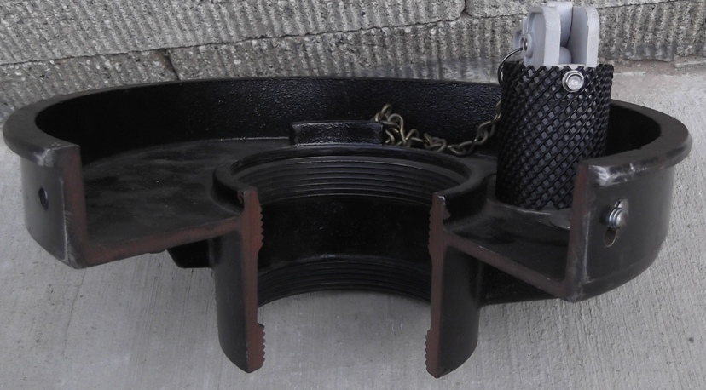
1-2100 SERIES DIRECT BURRY SPILL CONTAINERS
Cast Iron Base!
Notes:
Cast iron base spill containers thread pattern starts immediately at the base an can therefore be used with either the FSA-400 (tall) or FSA-400S (short) face seal adapter. You must use an JSK-4410CB Jack Screw assembly.

Slide 6
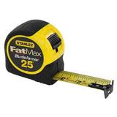
1-2100 SERIES DIRECT BURRY SPILL CONTAINERS
Remove all old components off of tank riser and ensure that riser and protective coating (pipe tape) are in good operating condition.
Set the riser length “L Dimension” to the specified height.
Notes:
Any metal that comes in contact with the backfill must be protected from the backfill including band clamps and tank risers. Verify the integrity of these items before installation is complete

Slide 7
1-2100 SERIES DIRECT BURRY SPILL CONTAINERS
“L DIMENSIONS”
5 Gallon Composite Base L= 15 5/8”
5 Gallon Cast Iron Base L= 14 ½”
15 Gallon Composite Base L= 19 5/8”
15 Gallon Cast Iron Base L= 18 ½”
Notes:
These L Dimensions already include the 1” slope of grade.

Slide 8
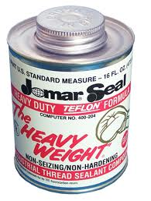
1-2100 SERIES DIRECT BURRY SPILL CONTAINERS
Clean and deburr tank riser pipe then apply a non hardening gas resistant pipe sealant the riser threads.

Slide 9
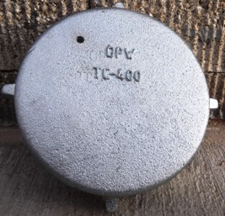
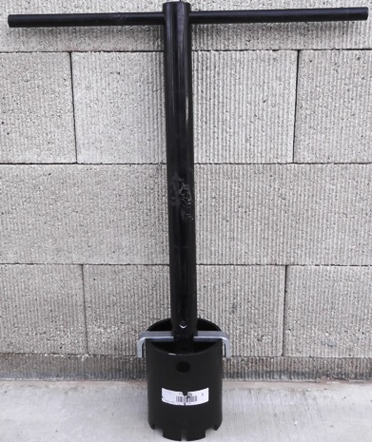
1-2100 SERIES DIRECT BURRY SPILL CONTAINERS
Before installing FSA adapter or spill container check riser torque by using TC-400 torque cap in conjunction with the 61-SA Tool
Notes:
When applying proper torque apply the highest value on the tank riser and successively work down as the components get installed.

Slide 10

1-2100 SERIES DIRECT BURRY SPILL CONTAINERS
Install the FSA adapter on the tank riser using the 61-SA Tool. The proper torque value is 125-250 FT LBS Apply pipe sealant to the threads on the FSA adapter.

Slide 11
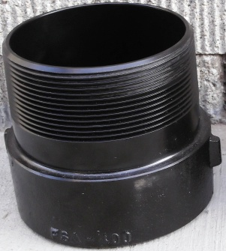
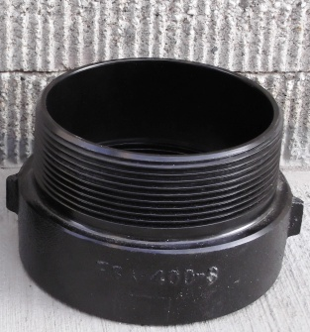
1-2100 SERIES DIRECT BURRY SPILL CONTAINERS
FSA-400
FSA-400S
Notes:
FSA-400 can be installed on both cast iron base and composite base spill containers and will add 3 ¼” to the overall “L dimension” . FSA-400 S can only be used with cast iron spill containers and will add 1 ¾” to the overall “L dimension”. Fill and tank probes are required to have an FSA adapter installed

Slide 12

1-2100 SERIES DIRECT BURRY SPILL CONTAINERS
Install the spill container. Make sure to stop when the container is hand tight.
Finish torqueing the spill container at the base with the 61-SA Tool. The proper torque is 125-250 FT LBS
Notes:
Do not attempt to torque the spill container by hand this could cause separation of the bellows seals and could potentially cause the container to leak. Containers must be torqued at the base of the container with the 61-SA Tool.

Slide 13
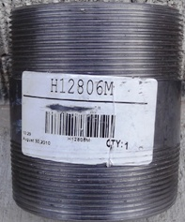
1-2100 SERIES DIRECT BURRY SPILL CONTAINERS
Apply pipe sealant to the factory supplied pipe nipple and use the TC-400 in conjunction with the 61-SA Tool to torque the nipple down. The proper torque value is 125-250 FT LBS. Install the OPW adapter and dust cap.
Notes:
Always use OPW factory supplied nipples to ensure a tight seal. The OPW factory nipple is cut on a machine lathe and is machined to have a flat sealing surface. When installing pipe nipples 61sa tool torque cap chain wrench and strap wrench can be used.

Slide 14
1-2100 SERIES DIRECT BURRY SPILL CONTAINERS
Overview
Fill and tank probe risers are required to have an FSA adapter installed
Vapor spill containers can not have a drain valve
When installing nipples in spill containers acceptable tools include the following; 61-SA Tool, Torque Cap, Chain wrench and Strap wrench
FSA-400 (Tall) can be used on both style spill containers

Slide 15
1-2100 SERIES DIRECT BURRY SPILL CONTAINERS
Overview
FSA-400S (Short) can only be used with cast iron base containers
Page 101 and 102 in the manual have most of the torque and “L dimensions” listed

Slide 16
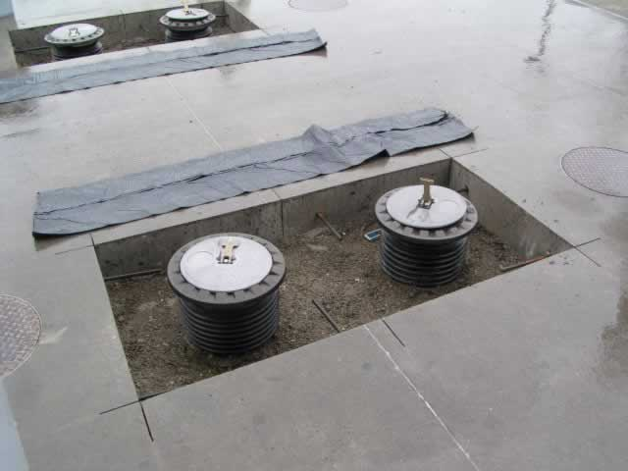
Questions?

Slide 17
700L/700L Remote Series Secondary Contained Spill Bucket
This product has been obsoleted, however it is still C.A.R.B approved and OPW offers still offers replacement parts.
Questions

Slide 18
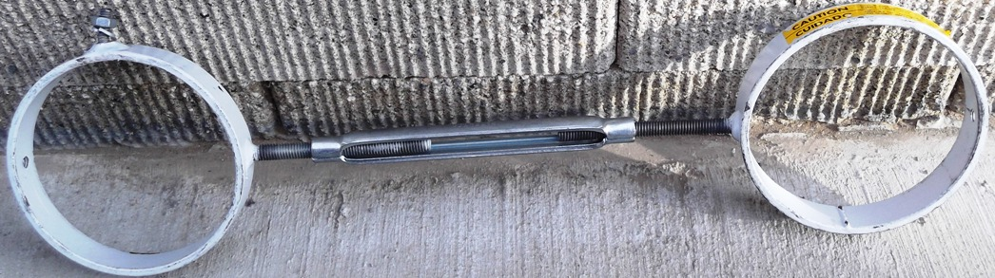
6511-RB16 Riser Spacer
Riser spacer is designed to keep risers at 16” centers.
Notes:
keeping the risers at 16” centers will help relive unwanted stress on the spill container and Multi Port assembly
It is offered in a slip fit style ( usually installed prior to FSA and spill containers) or a clamp style which could be installed as a retrofit.

Slide 19
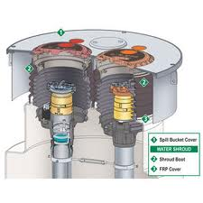
POMECO MULTI-PORT SPILL CONTAINMENT MANHOLE INSTALLATION
Mark off finish grade
Set multi-port assembly to the final grade.

Slide 20
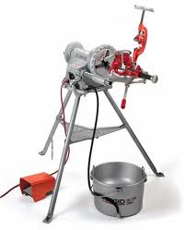
POMECO MULTI-PORT SPILL CONTAINMENT MANHOLE INSTALLATION
Remove the cover
Cut the tank risers to required height (spill container “L dimension”)

Slide 21
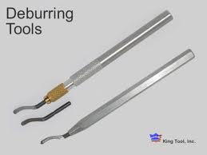
POMECO MULTI-PORT SPILL CONTAINMENT MANHOLE INSTALLATION
Deburr and clean riser pipes. Verify the torque value.
Apply pipe sealant to the riser threads.

Slide 22
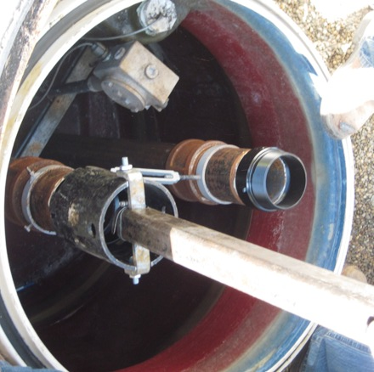
POMECO MULTI-PORT SPILL CONTAINMENT MANHOLE INSTALLATION
Install the FSA adapter and torque to the specified value. The specified torque value is 125-250 FT LBS.

Slide 23
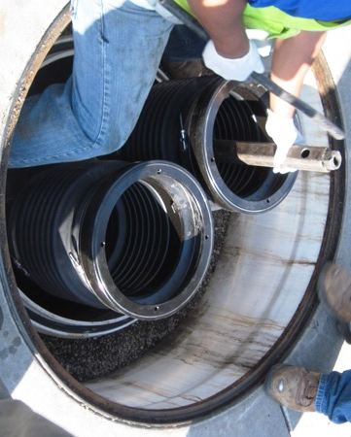
POMECO MULTI-PORT SPILL CONTAINMENT MANHOLE INSTALLATION
Thread Spill Container on tank riser
Finish torqueing with the 61-SA Tool. Proper torque is 125-250 FT LBS.
Notes:
Do not attempt to torque container by hand this could cause the seals to fail.

Slide 24
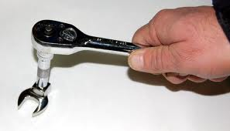
POMECO MULTI-PORT SPILL CONTAINMENT MANHOLE INSTALLATION
Install the multi-port cover. Take precautions not to move or damage the gaskets and O-rings.
Install mounting rings and use a crows foot wrench and a torque wrench to apply the proper torque. The proper torque is 15-20 FT LBS.

Slide 25
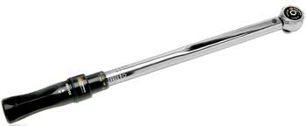
POMECO MULTI-PORT SPILL CONTAINMENT MANHOLE INSTALLATION
Apply proper torque to Roto lock bolts . The proper torque is 40-50 FT LBS.
Preform regulatory compliance tests before pouring concrete.

Slide 26

POMECO MULTI-PORT SPILL CONTAINMENT MANHOLE INSTALLATION
Do Not Over Tighten !!
Follow factory torque settings
Torque in succession

Slide 27
Retrofit & Upgrades
Special Order Multi-Ports
Take your own measurements
Fill out the forms yourself
Include pictures
Measurements
Configuration
Pictures

Slide 28
6521XAR Adaptor Ring
The 6521XAR Adaptor Ring is designed to replace an existing manhole with a POMECO Roto Lock style manhole
The adapter ring provides an adequate surface and stable structure for the Roto Lock to engage!

Slide 29

Multi-Port Water Shroud
Apply a even bead of SL-1100 sealant to SLPK gasket groove
Install SLPK gasket on tank sump top hat

Slide 30
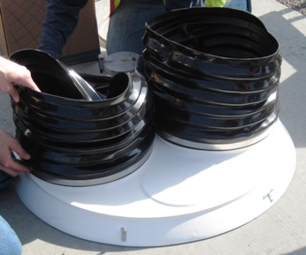
Multi-Port Water Shroud
Install 2 shroud boots and 4 band clamps
Install FRP fiberglass cover over spill containers and onto gasket

Slide 31
POMECO 500 Series
Maintenance
Remove all lids and cover
Inspect Roto Locks and replace any components that have visual signs of damage
Thoroughly clean all gasket and O-ring sealing surfaces
Apply grease to Roto Lock bolt, replace washers and re install Roto Locks
Check Roto Lock Clearance
Replace worn or damaged O-rings and gaskets before installing cover

Slide 32
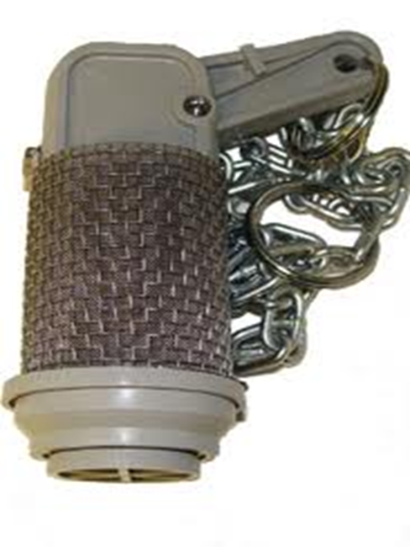
1DK-2100 Series Drain Valve
Clean spill container prior to removing drain valve
If replacing the valve discard all old hardware and valve
Apply grease to the new O-ring and container cavity
Install valve and new hardware and torque nuts @ 11.5 to 13.5 FT LBS

Slide 33
61SO-Overfill Prevention Valve
This product has been obsoleted,
However the 61SO is still C.A.R.B approved and could still be installed.

Slide 34
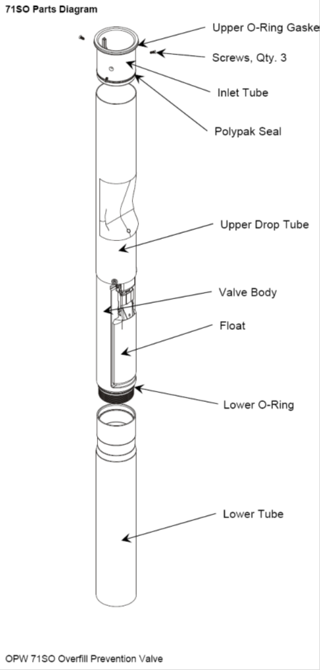
71SO-EVR Overfill Protection Valve
Following the instructions for the OPW 71SO installation will provide initial shutoff at 95%

Slide 35
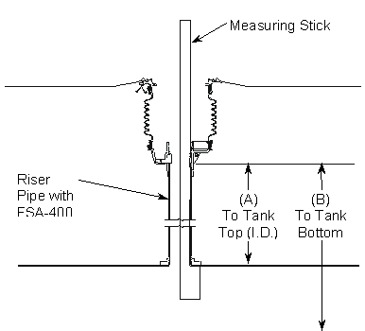
71SO-EVR Overfill Protection Valve
Use the measuring stick provided to obtain length from inside top of the tank to the top of the FSA adapter (A)

Slide 36
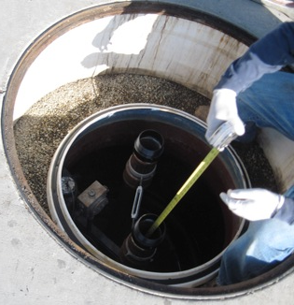
71SO-EVR Overfill Protection Valve
Use a tape measurer to obtain the length from the bottom of the tank to the top of the FSA adapter (B)

Slide 37
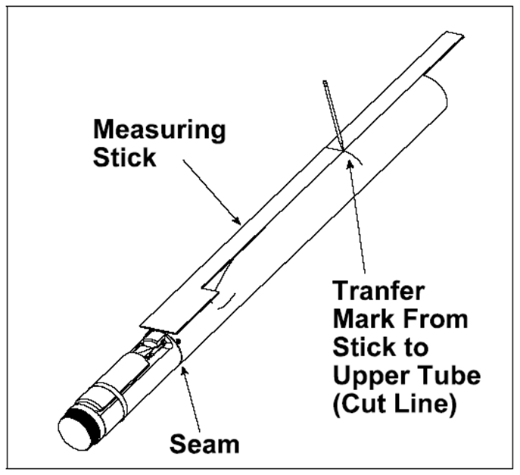
71SO-EVR Overfill Protection Valve
If the 95% calculation requires the valve to be set at 6.5” or less use the measuring stick provided to mark the upper tube

Slide 38

71SO-EVR Overfill Protection Valve
If the 95% calculation requires the valve to be set at 6.5” or more measure the distance from the inside top of the tank to the top of the FSA adapter and add 6.5”

Slide 39
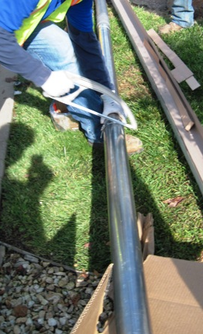
71SO-EVR Overfill Protection Valve
Mark Tube
Use band clamp to keep cut straight
Use a fine tooth hack saw and make the straightest cut possible
Notes:
Fine tooth hack saw will make a clean cut. Do not use a sawzall or tube cutter it could deform the tube making it harder to insert the inltet adapter or cause it to leak after installation.

Slide 40
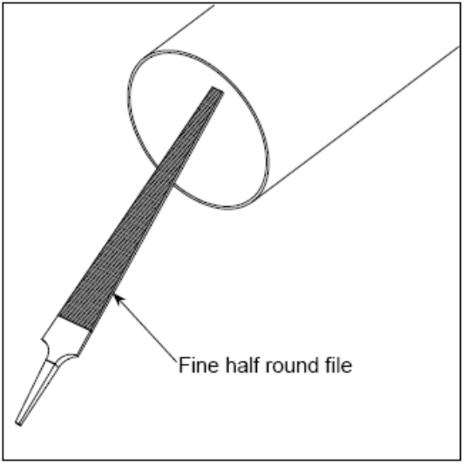
71SO-EVR Overfill Protection Valve
Use a half round file and create a good chamfer on the upper tube
Use a fine grit sand paper or emery cloth to further prepare the surface

Slide 41
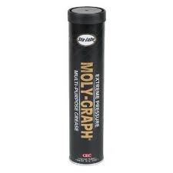
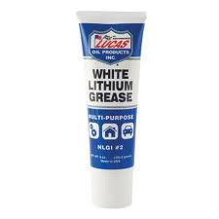
71SO-EVR Overfill Protection Valve
Thoroughly clean the upper tube with a clean rag and acetone
Apply grease to inside of upper tube and inlet adaptor
Notes:
Be sure that all of the metal shaving have vacated the valve assembly before completing the installation .

Slide 42
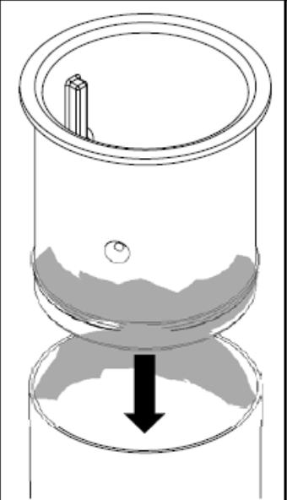
71SO-EVR Overfill Protection Valve
Insert the inlet tube
If inlet tube is not sliding into place lay a piece of 2X4 across the top and apply steady blows with a small sledge hammer until inlet is seated
Notes:
Be sure the valve is not sitting on the bear concrete

Slide 43
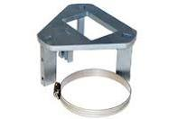
71SO-EVR Overfill Protection Valve
Slide OPW 71SO-ToolC over inlet and synch down the set screw to ensure the unit does not move

Slide 44
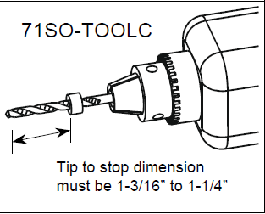
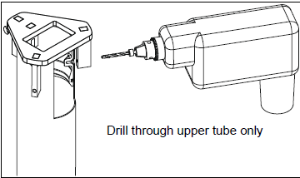
71SO-EVR Overfill Protection Valve
Check the pre set drill bit before drilling first hole
Drill all 3 holes then remove the 71SO-ToolC

Slide 45
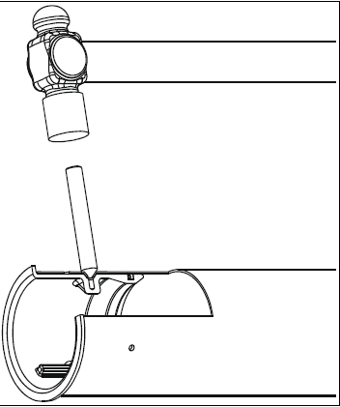
71SO-EVR Overfill Protection Valve
Dimple the first hole
Apply grease to the tap tight screw and install
Dimple the other two holes and install tap tight screws
Torque tap tight screws @ 20- 30 IN LBS

Slide 46
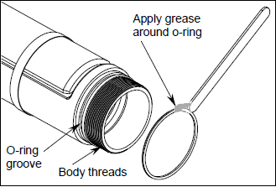
71SO-EVR Overfill Protection Valve
Apply grease to lower O-ring and threads
Thread lower tube onto upper tube assembly using a chain or strap wrench.

Slide 47
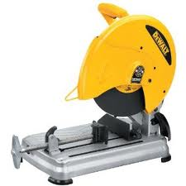
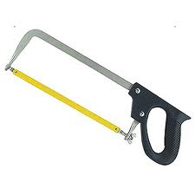
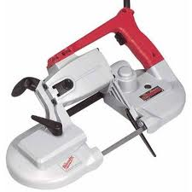
71SO-EVR Overfill Protection Valve
Measure from the top of the FSA adapter to the bottom of the tank
Subtract no more than 6 inches and mark the bottom of the tube
Cut lower tube per local code

Slide 48
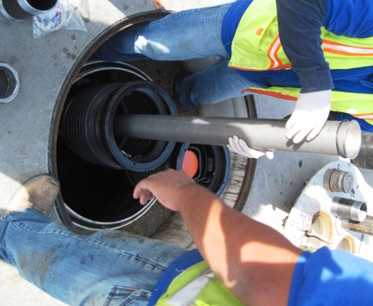
71SO-EVR Overfill Protection Valve
Insert drop tube assembly into tank riser
Ensure the elastic band holding down the float is removed
Align the float long ways with the tank

Slide 49
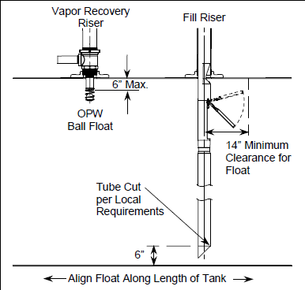
71SO-EVR Overfill Protection Valve
Ball floats must be set higher than the 71SO valve
Continue the installation of the jack screws assembly , nipple and adapter

Slide 50
71SO-EVR Overfill Protection Valve
Overview
To obtain top tube measurement the dimension is recorded from the inside of tank bung to the top of the FSA
No epoxy is required to install the 71SO
First step in removing the 71SO is to loosen the Jack screws assembly
Tap tight screws get torqued @20-35 IN LBS

Slide 51
71SO-EVR Overfill Protection Valve
Overview
Things that could cause the upper inlet tube to fail; over tightening the jack screws, not cutting the upper tube square, and tightening the nipple in the spill container after tightening the jackscrews
When using the 71SO ball valves must be installed higher than the overfill valve

Slide 52
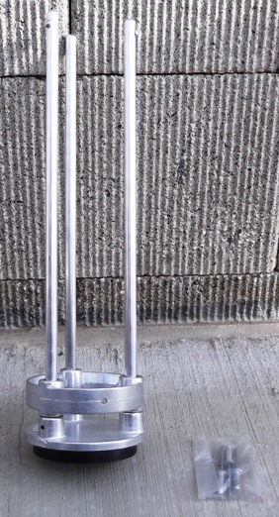
6111-1400 Tank Bottom Protector
If a tank bottom protector is installed always reinstall the unit when changing drop tubes
Drill 3 holes in the specified areas and install the supplied pop rivets

Slide 53
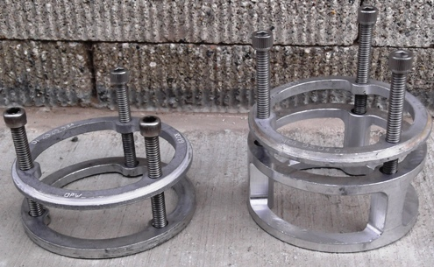
61JSK Jack Screw Assembly's
61JSK-44CB 61JSK-4410

Slide 54
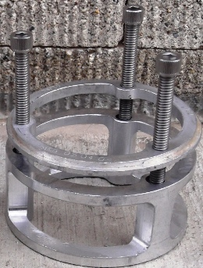
61JSK Jack Screw Assembly's
Insert lower cage into spill container and place on top of the drop tube with the screw beds facing up
Apply Lock Tight to screw threads and loosely thread screws into the upper cage

Slide 55
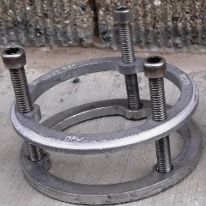
61JSK Jack Screw Assembly's
Insert the upper cage into spill container on top of the lower cage making sure the screws sit in the beds
Install Nipple
Use ¼” Allen socket and evenly torque screws @ 3.5 to 5 IN LBS

Slide 56
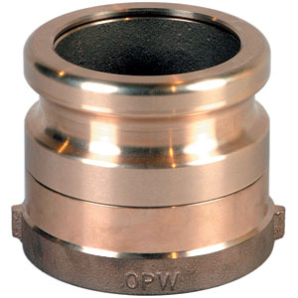
61SALP EVR Rotatable Product Adapter
Thread on spill container nipple use 61SA Tool and torque @ 90 to 110 FT LBS
Static torque of 108 IN LBS or less
Replacement parts:
Nipple sealing gasket OPW P/N H09039M

Slide 57
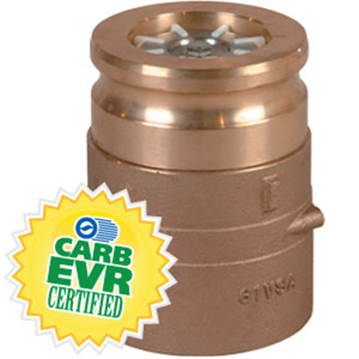
61VSA EVR Rotatable Vapor Recovery Adapter
Thread on spill container nipple use 61SA Tool and torque @ 90 to 110 FT LBS
Static torque of 108 IN LBS or less
Replacement Parts:
Nipple sealing gasket OPW P/N H09039M
Vapor poppet Kit
OPW P/N 61VSA-KIT

Slide 58
623 Pressure Vacuum Vent
This product has been De-certified , however if it is still installed it will require a annual visual inspection and cleaning. The unit can remain in service until May 30th 2012
Questions?

Slide 59


Installation Tools
61SA-Tool
TC-400 TORQUE CAP

Slide 60
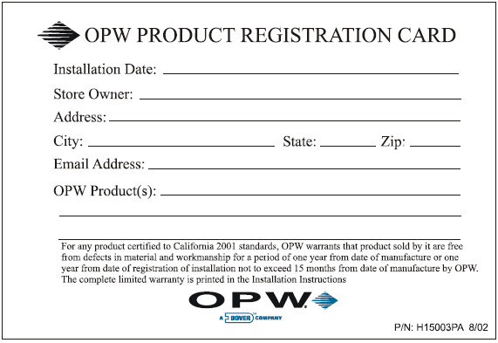
Registration Card
Fill registration cards out and send them in to OPW

Slide 61
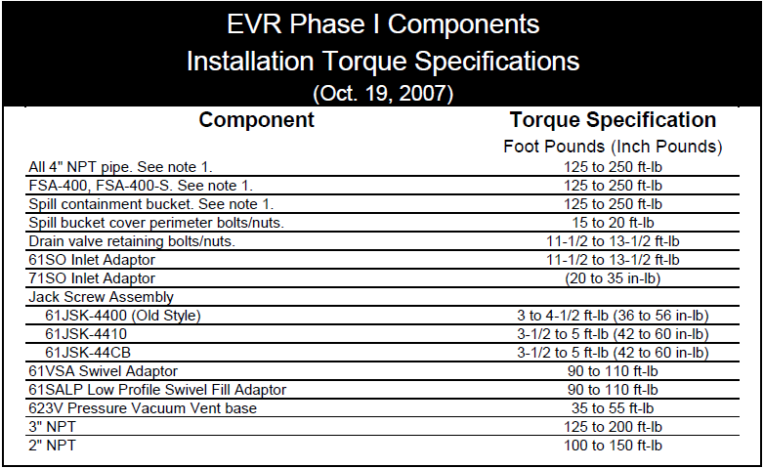
Torque Specifications

Slide 62
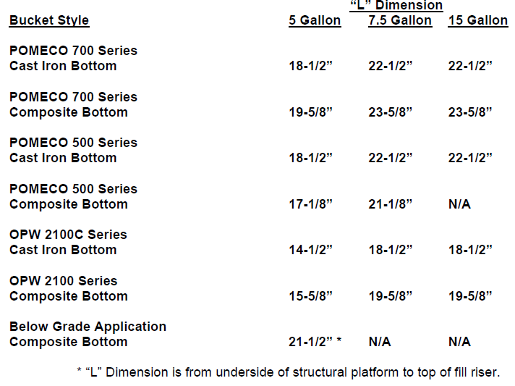
“L” Dimensions

Slide 63
1-3100 Series Spill Containers
Edge single wall will require the use of an FSA adaptor
Edge single wall “L” dimension 5 gallon cast iron base with FSA-400S: 151/2”

Slide 64
1-3100 Series Spill Containers
Edge double wall spill container “L” dimension: 15 5/8”

Slide 65
1-3100 Series Primary and Secondary Bucket Replacement Instructions
The Edge single wall and double wall Bucket comes fully assembled and will not require disassembly to install!

Slide 66


Slide 67
1-3100 Series Spill Containers
Questions

